Slide 10
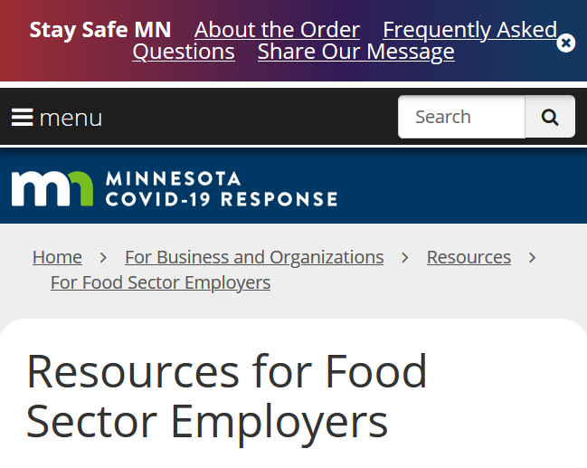

Slide 12
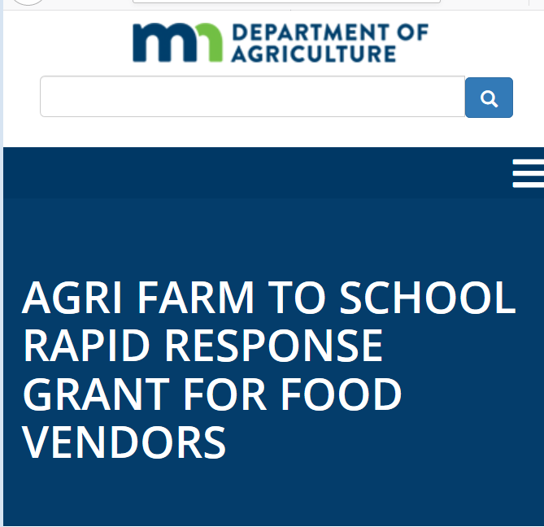

Slide 22
https://www.mda.state.mn.us/sites/default/files/inline-files/COVID-19%20MN%20Farmers%27%20Markets-Vendors%20Guidance%20Hmong%20June%202020.pdf

Slide 23
https://www.mda.state.mn.us/sites/default/files/inline-files/COVID-19%20MN%20Farmers%27%20Markets-Vendors%20Guidance%20Spanish%20June%202020.pdf

Slide 26
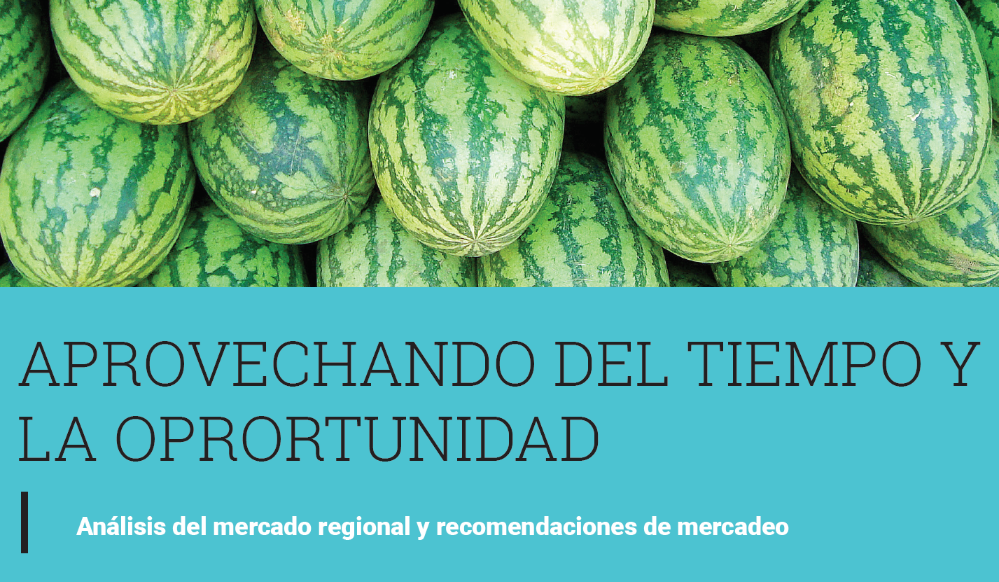

Slide 29
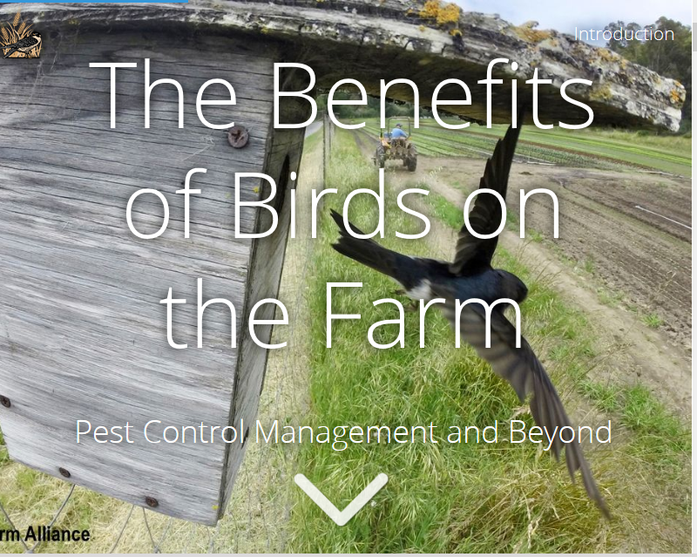

Slide 38
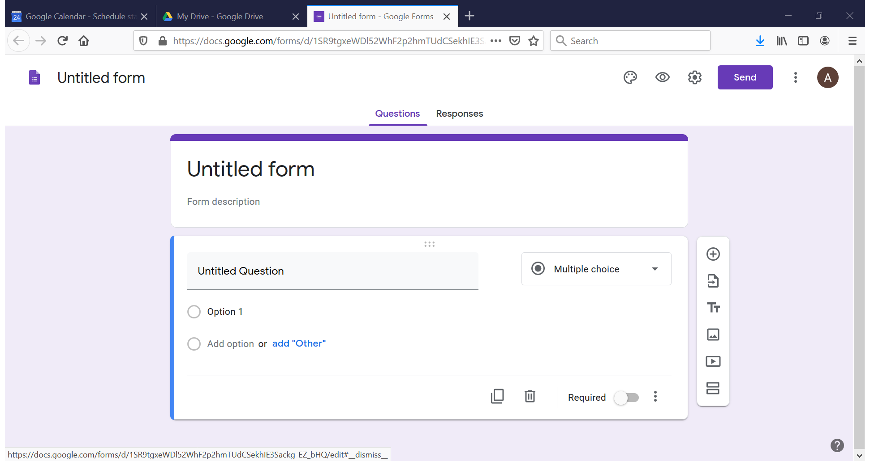

Slide 39
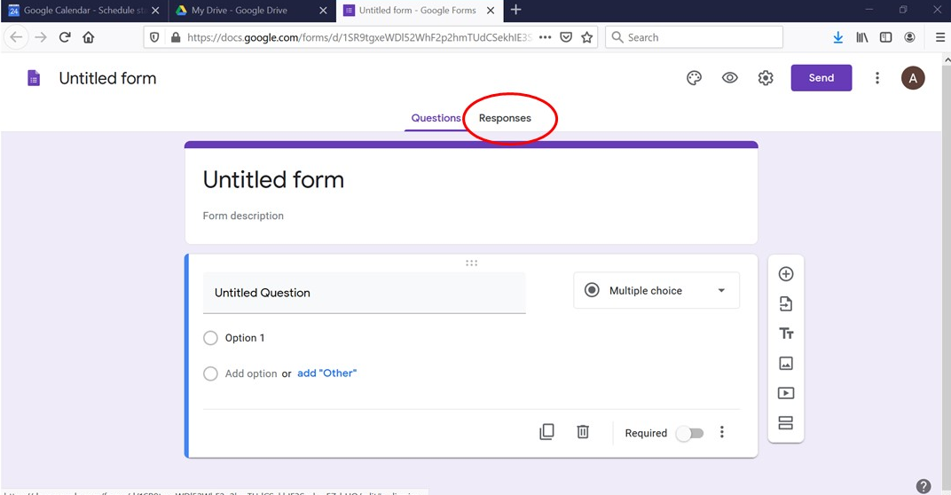

Slide 43
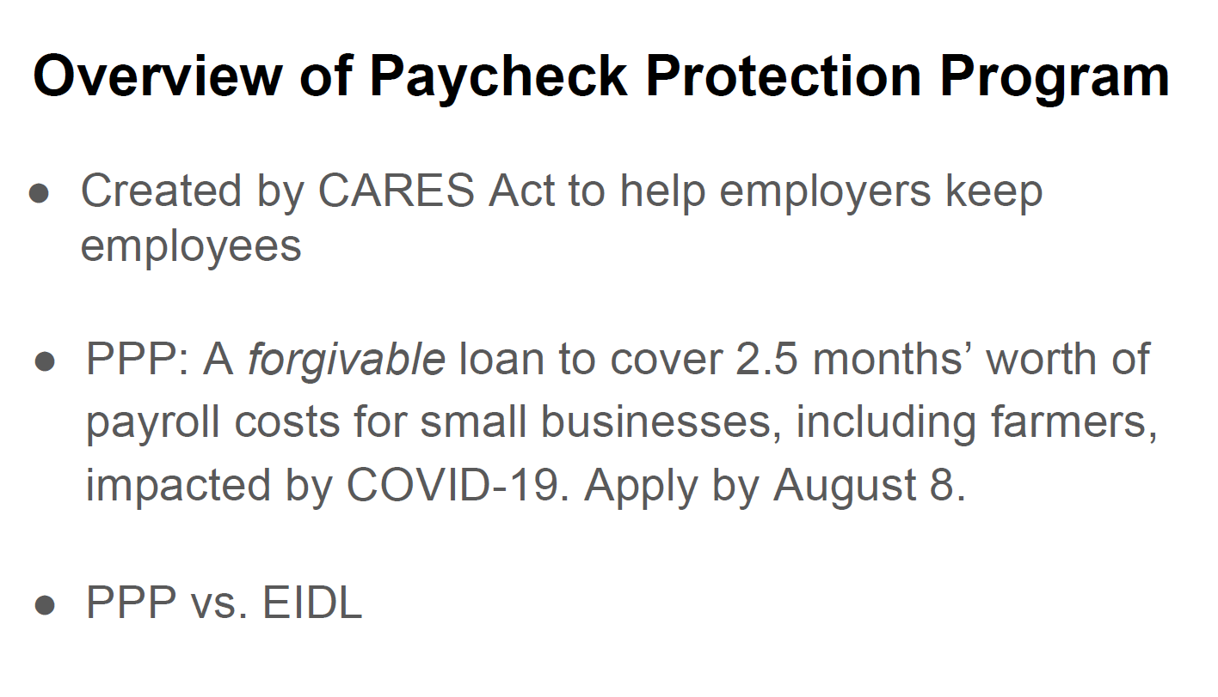

Slide 44
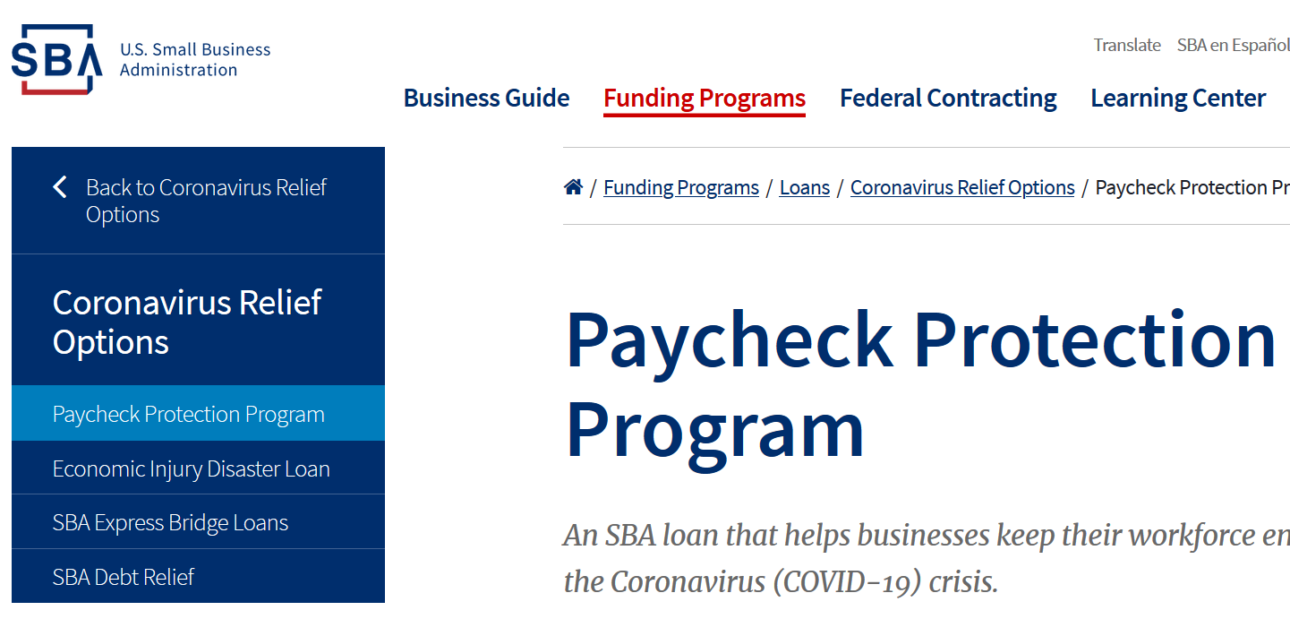

Slide 45
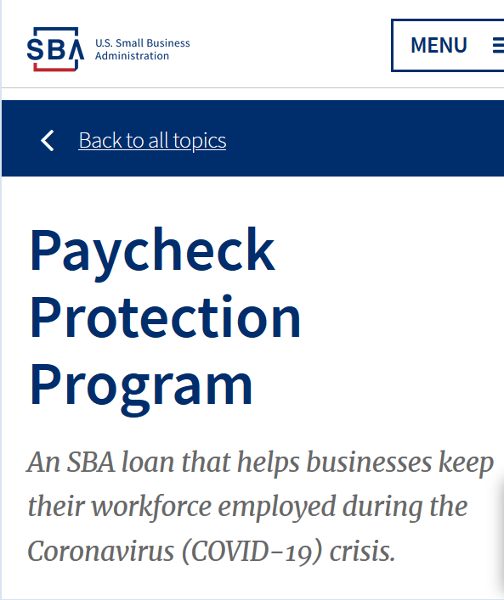

Slide 47
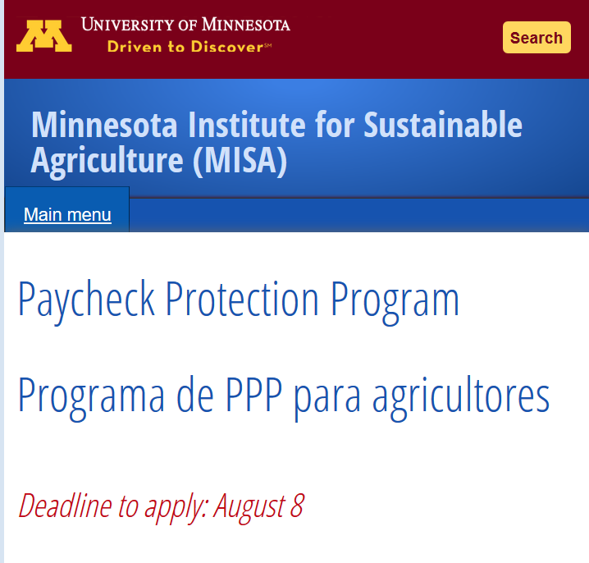

Slide 52
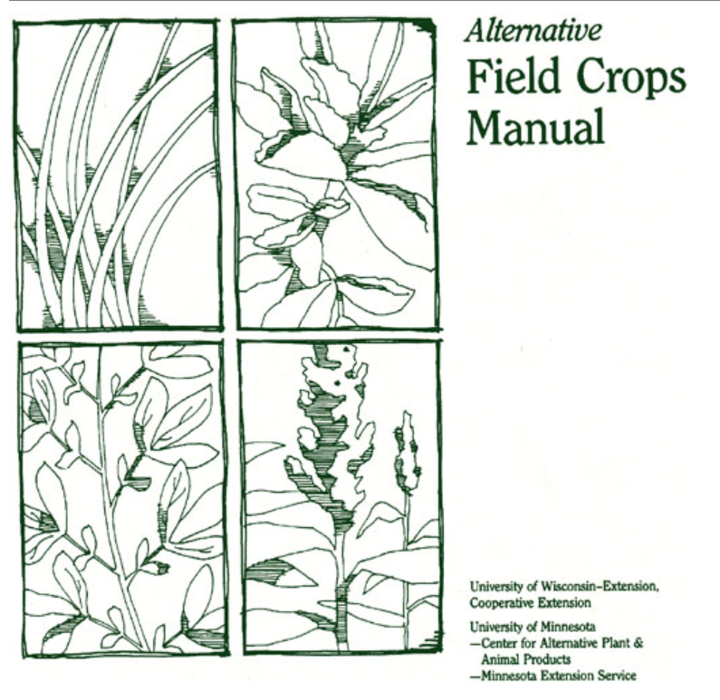

Slide 53
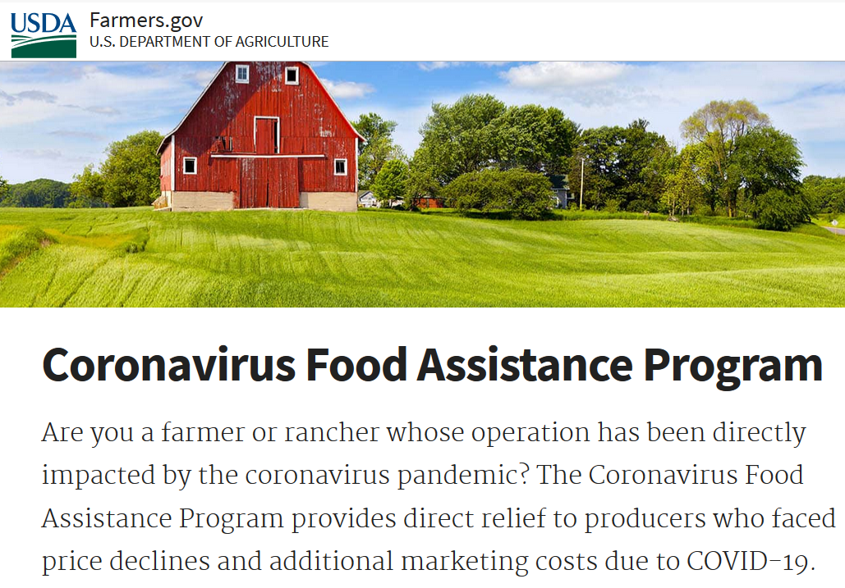

Slide 55
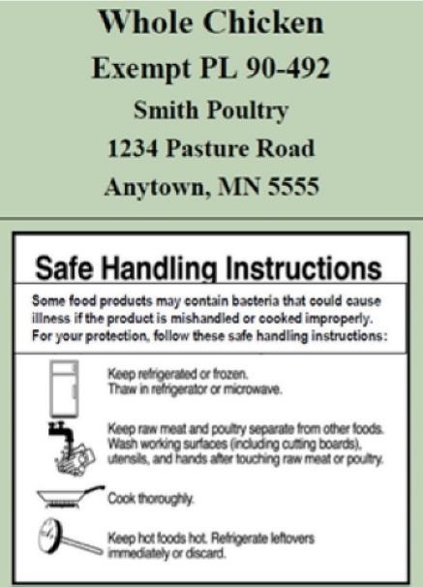
Exempt Whole Rabbit
Rush River Rabbitry
1234 Pasture Road
Anytown, MN 5555x

Slide 58
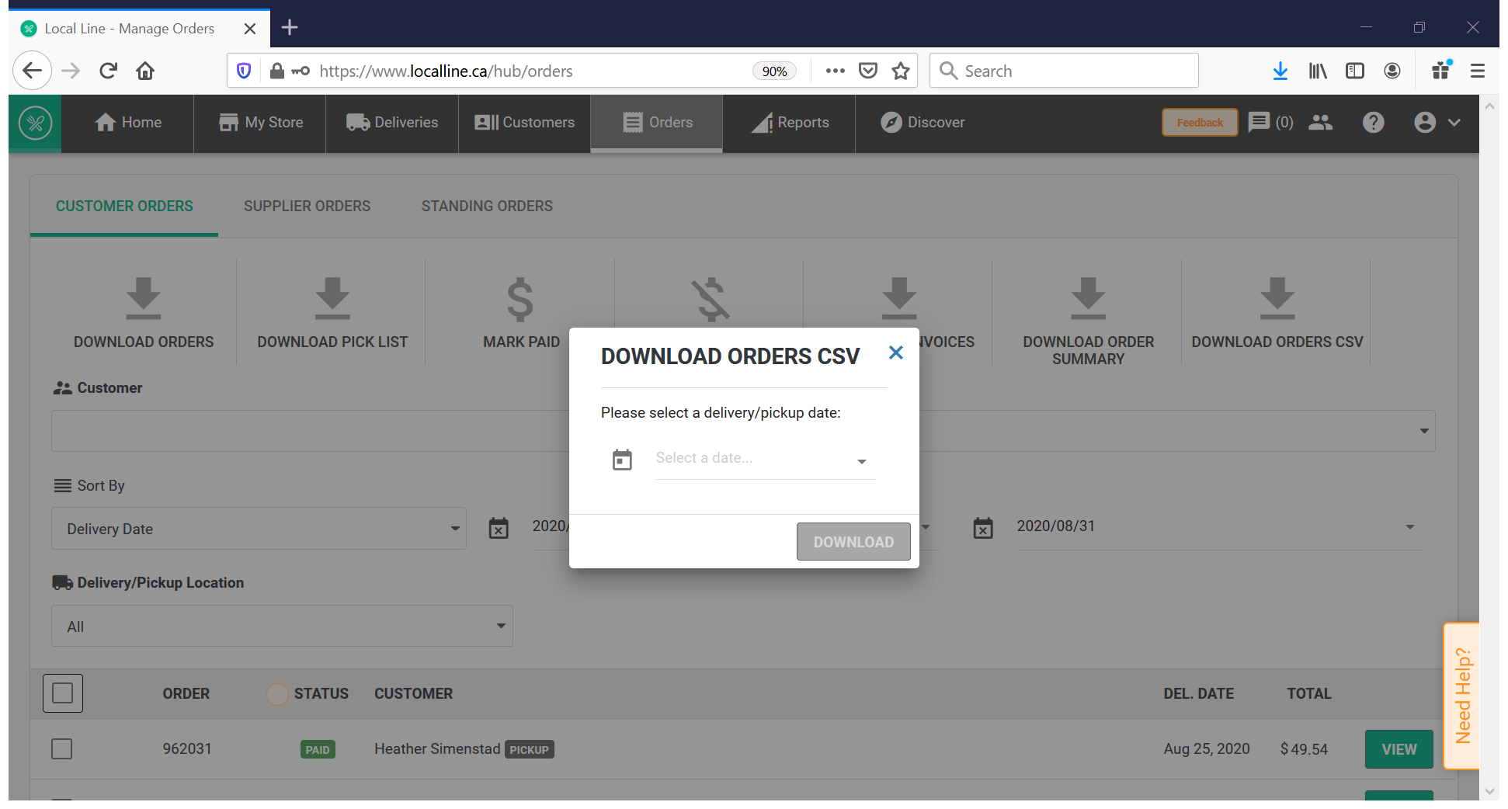

Slide 61
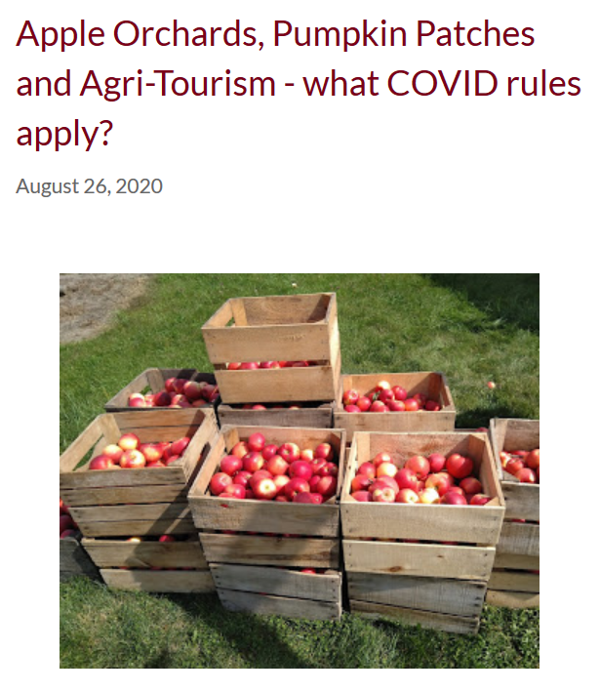

Slide 63
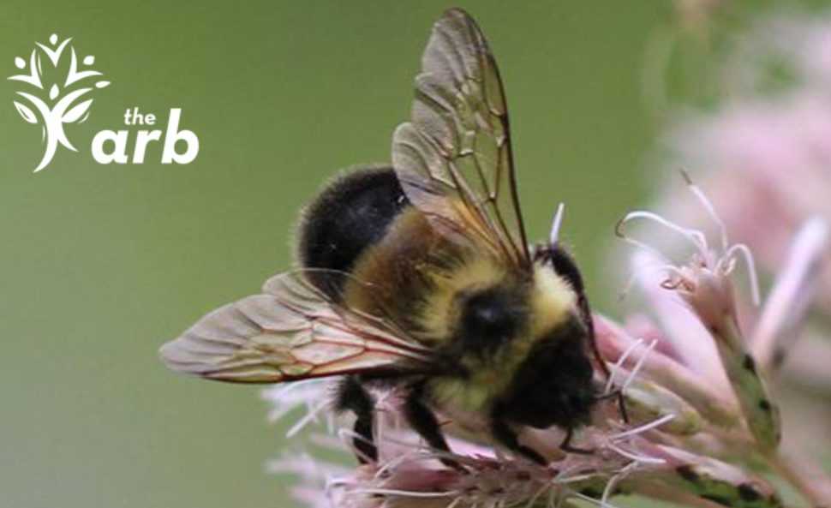

Slide 82
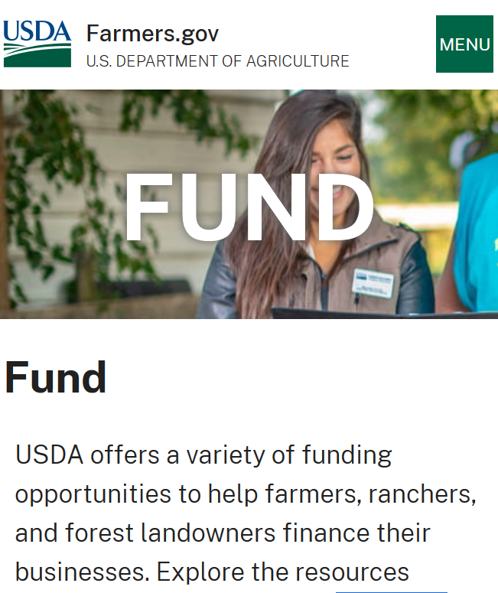

Slide 91
Cornercopia Student Farm

Slide 95
Grants for Farmers

Slide 127
Market Farmer
Financial Benchmarks 2019 data

Slide 139
June 10, 2021 Webinar:

Slide 145
Sustainability
Economics
Environment
Quality of life

Slide 158
Image: Adapted from Food Allergy Research and Education (FARE) and photo by Raspopova Marina on Unsplash.com

