Slide 1
Local Food Advisory Committee
What is it?
Why do we have it?
February 16, 2013
Sustainable Farming Association Conference

Slide 2
Why?
Confusion among farmers and others on what the rules are for selling local food
Inconsistent information from MDA and MDH inspectors
Rapid change in the size and complexity of the local food scene

Slide 3
Confusion

Slide 4
Inconsistency
Confusion

Slide 5
Inconsistency
Confusion
Rapid Change

Slide 6
Inconsistency
Confusion
Rapid Change
Trouble!

Slide 7
Issue Areas:
Local Meat & Poultry Sales
Meat Processing
Farmers’ Markets
Processed Local Products
Farm-to-School/Institutional Sales
Restaurants
Grocery Stores

Slide 8
History
Years of ongoing conversations among MISA, U of MN Extension, MDA Dairy & Food Inspectors
Endowed Chair in Agricultural Systems held by Jan Joannides in 2010-2011; worked on meat processing issues

Slide 9
History
Sustainable Farming Association secures FMPP grant to work on local meat sales & processing, late 2011
SFA, U of MN Extension, MISA, and Endowed Chair approach MDA about forming advisory committee, August 2012

Slide 10
History
Core steering committee began meeting in September, 2012
Mission, scope, operating documents developed through end of 2012

Slide 11
Steering Committee:
University of Minnesota Extension
Sustainable Farming Association
Renewing the Countryside
Minnesota Institute for Sustainable Agriculture
Minnesota Farmers Market Association
Minnesota Department of Agriculture

Slide 12
History
Letters of invitation to farmer organizations and other stakeholders sent out end of Dec. 2012
First official Local Food Advisory Committee meeting held January 30, 2013

Slide 13
Advisory Committee Participants
Homegrown Minneapolis
Just Food Co-op (Northfield)
Mike Phillips – Three Sons Meat Co.
MN Association of Meat Processors
MN Department of Agriculture
MN Department of Health
Minnesota Grown
MN Farmers Market Association
MN Farmers Union
MN Institute for Sustainable Ag
Renewing the Countryside
Sustainable Farming Association
U of MN Extension
U of MN Meat Science

Slide 14
Mission
Help the State of Minnesota to achieve its goals with respect to meat and food safety by serving as a conduit between MDA, MDH, other agencies, and the community/farmers/stakeholders in regards to the production, processing, marketing and distribution of local foods

Slide 15
What are “Local Foods?”
We are focusing on the sector of the food system that includes foods for direct human consumption that are raised, gathered, or processed by farmers, farmer groups, or non-farm individuals for direct sales to:
Individual consumers
Buyers who re-sell the products to individual consumers
Business entities that act as brokers or distributors, but retain some level of producer identity with the products

Slide 16
Goals
Help communicate to stakeholders what the rules are
Help to make the rules and information more transparent and clear
Ensure consistent interpretation of the rules across the system

Slide 17
About the Committee
Non-adversarial and co-operative
MDA and MDH are integral to the committee
MDA and MDH commit to provide staff presence at the meeting, to bring forth issues of importance, and to listen

Slide 18
What it’s NOT!
A way to make changes to statutes
Open season for complaints
Rubber-stamp for MDA and MDH decisions

Slide 19
Scope
Provide a non-adversarial forum to work collaboratively toward common goals:
reducing food-borne illness
fostering a robust local food sector.

Slide 20
Scope
Provide an opportunity for public discussion and a means for the public to submit comments to the MDA and MDH

Slide 21
Scope
Represent the pertinent stakeholders
Communicate issues to & from the committee
Surface questions and concerns related to production, processing, marketing and distribution

Slide 22
Scope
Advise on:
- communication strategies
- educational materials
that the MDA and MDH develop

Slide 23
Scope
Help facilitate outreach and education to stakeholders.
Ensure that meeting proceedings are recorded and transmitted outside the group.

Slide 24
Staffing
This committee has no budget !!
No travel funds
No per diem funds
No staffing funds
Staff support is currently provided by Wayne Martin (U of MN Extension), Jan Joannides (Renewing the Countryside), and Jane Jewett (MISA)

Slide 25
Meetings
Quarterly in-person meetings
Devote time to each issue area at meetings
Conference calls & emails in between if needed
Issue-area subcommittee meetings if needed

Slide 26
Issue Areas:
Local Meat & Poultry Sales
Meat Processing
Farmers’ Markets
Processed Local Products
Farm-to-School/Institutional Sales
Restaurants
Grocery Stores

Slide 27
How to Connect
Contact a committee member
Use the comment form:
www.misa.umn.edu >> Contact >>
Comments for Local Food Advisory Committee
Listening Sessions

Slide 28
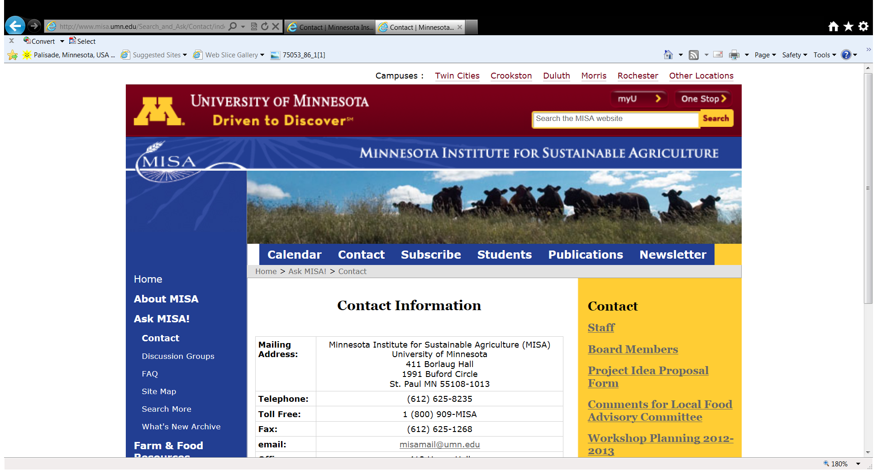

Slide 29
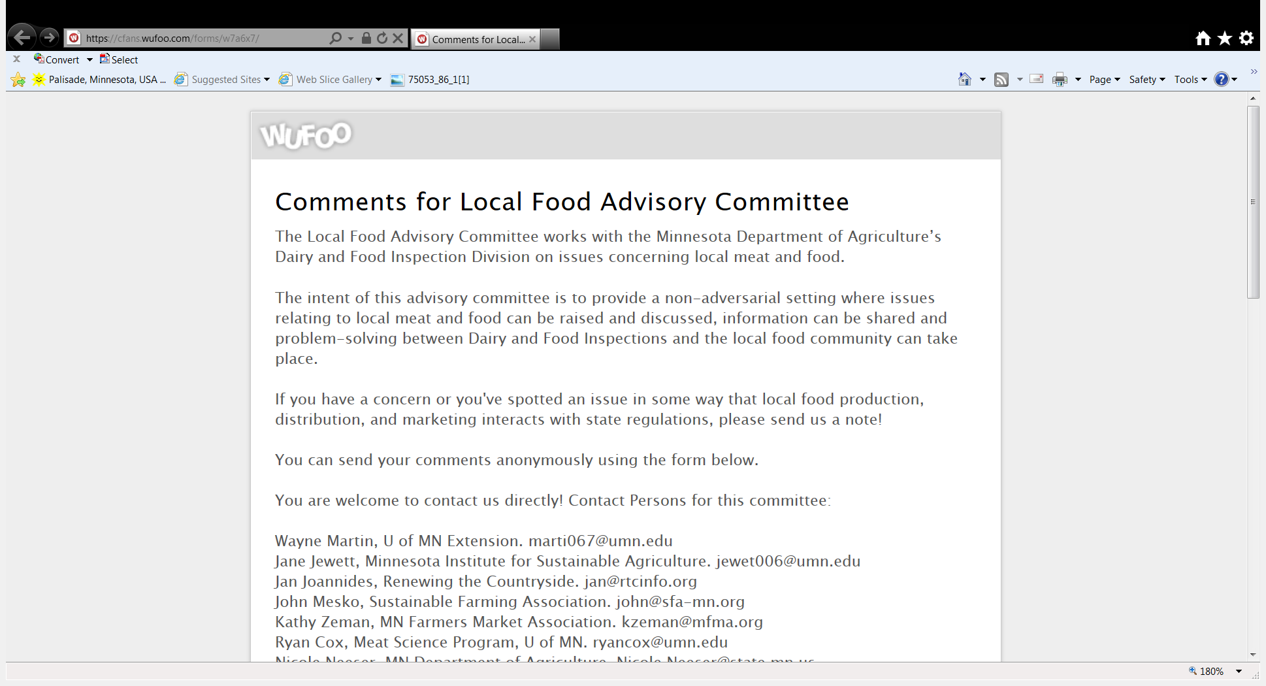

Slide 30
Advisory Committee Participants
Megan O’Hara (Homegrown Mpls)
Patrick Neily (Just Food)
Mike Phillips – Three Sons Meat Co.
Jon Christiansen (MAMP)
Nicole Neeser (MDA)
Jennifer Stephes (MDA)
Colleen Paulus (MDH)
Sarah Leach (MDH)
Paul Hugunin (Minnesota Grown)
Kathy Zeman (MFMA)
Doug Peterson (MFU)
Jane Jewett (MISA)
Jan Joannides (RTC)
John Mesko (SFA)
Wayne Martin (U of MN Ext.)
Katherine Waters (U of MN Ext.)
Ryan Cox (U of MN Meat Science)

