Slide 1
Question 1: Have you ever been involved with or tried to start a food business, enterprise or activity in Minnesota?

Slide 3
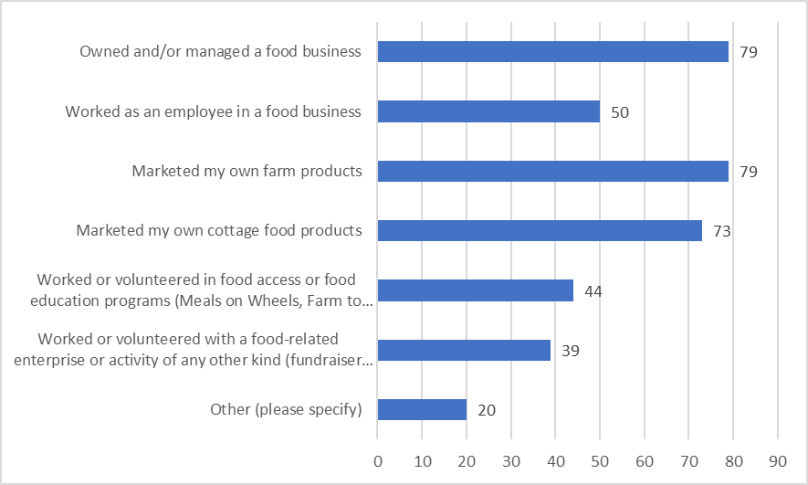
Question 2: In what types of food business, enterprise or activity have you been involved? Check all that apply.

Slide 5
How did you find information about food regulations and requirements for your business, enterprise or activity? Check all that apply.

Slide 7
Were you able to get enough information to allow you to proceed with your food business, enterprise or activity?

Slide 8
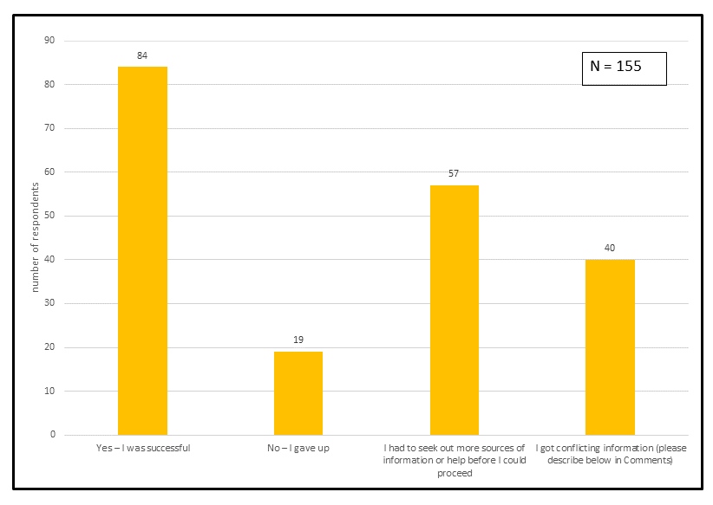

Slide 9
Were you able to get enough information to allow you to proceed with your food business, enterprise or activity?
N=155

Slide 11
Did you feel like you knew where to go to get information or help for your food business questions?
No
Yes
N=156

Slide 13
Question 6. Did you feel like you knew what to do in order to meet requirements for your food business?

Slide 15
If you decided to stop pursuing your food business, enterprise or activity, can you tell us why?
N = 74

