Slide 1
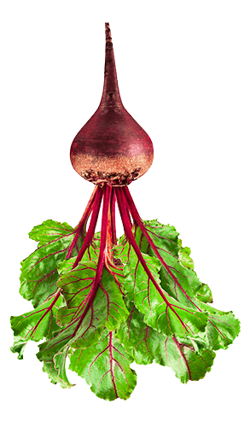
Blazing Trails through the Jungle of Local Food Regulations
A project of Minnesota Institute for Sustainable Agriculture, Renewing the Countryside, and Minnesota Farmers’ Market Association
Funded by:
North Central Sustainable Agriculture Research & Education Program
(NCR-SARE)

Slide 2
Who We Are
Jane Grimsbo Jewett Associate Director
Minnesota Institute for Sustainable Agriculture
University of Minnesota jewet006@umn.edu
Kathy Zeman
Executive Director
Minnesota Farmers’ Market Association kzeman@mfma.org
Brett Olson
Creative Director & Co-Founder
Renewing the Countryside brett@rtcinfo.org

Slide 3
Who Is Helping Us
Local Food Advisory Committee
Minnesota Department of Health
Food, Pools, and Lodging Section
Statewide Health Improvement Partnership
Minnesota Department of Agriculture
Food and Feed Safety Division
Dairy and Meat Inspection Division
Notes:
Local Food Advisory Committee has been meeting quarterly since January 2013. It is a meeting of food regulators from the Minnesota Department of Agriculture, Minnesota Department of Health, and sometimes MDH delegated authorities; staff from the University of Minnesota; and people representing sustainable agriculture and local food-oriented organizations. The meetings are a space where issues around local food and state regulations can be discussed and resolved.

Slide 4
Why This Project?
All three of us have worked with local food systems in Minnesota for many years, and have witnessed and experienced confusion about regulations.
We have seen good ideas struggle and sometimes fail because of confusion and misinformation about regulations.
Knowledge is power! We have knowledge to share.

Slide 5
Why Now?
We have funding from the Sustainable Agriculture Research & Education Program of USDA
We have a collection of useful materials created over the past 5 years with assistance from the MN Department of Agriculture and MN Department of Health
Local food is in demand, innovative food business models are multiplying, and understanding of regulations needs to catch up.

Slide 6
What We Will Do:
Train farm educators, food system advocates and educators, and leaders in the agriculture and food communities on the basics of regulation of local food enterprises and systems
Provide reference materials and a PPT presentation to trainees so they can become resource people in their communities
- Printed binder + flash drive containing key reference materials

Slide 7
What Topics Will We Cover?
The landscape of food regulation: federal, state, local (statute & rule)
Exclusions and exemptions from licensing
Jurisdiction among regulatory agencies for licensing and inspection
License types issued by MDA
License types issued by MDH
Delegation authorities
Food Innovation Team

Slide 8
What this IS:
Information about how to navigate the regulations that exist and how to find help if you’re stuck
What this is NOT:
Advocacy to change laws, complain about the laws, or figure out how to circumvent the laws
Notes:
Advocacy to change laws is important work, and anyone who wants to undertake that effort can certainly do that. There are plenty of areas of the law that could use some updating – but we’re not going to get into it in this presentation.

Slide 9
What this IS:
Information to increase your awareness and understanding of how and when to ask questions
What this is NOT:
You won’t know everything about the details of the law at the end of this training.
Notes:
But you will have the binders, or the list of references that are available online. You don’t have to know everything, but it helps if you know where to go look it up.

Slide 10
Where and When?
All 87 counties in Minnesota
Tribal Nations
January 2019 through August 2020

Slide 11
Reference Materials
Notes:
All of the reference materials shown on the next slides, plus more, are listed in your Resources list and included in the binder and flash drive. All are available for free online.

Slide 12
Reference Materials
Tier 1 & Tier 2 are what we will cover
Center for Integrated Agricultural Systems, University of Wisconsin. 2010.
Notes:
This can be a useful diagram to set the boundaries of what we mean by “local food.” There are large corporations with national and global reach that have Minnesota as their headquarters location, and sometimes there are questions about why those aren’t considered “local food.” This diagram and the accompanying text provide a basis for us to say that local food means direct sales from farmers to consumers, and sales by farmers to strategic partners in supply chain relationships that maintain some of the identity of the product as it moves from farmer to consumer.

Slide 13
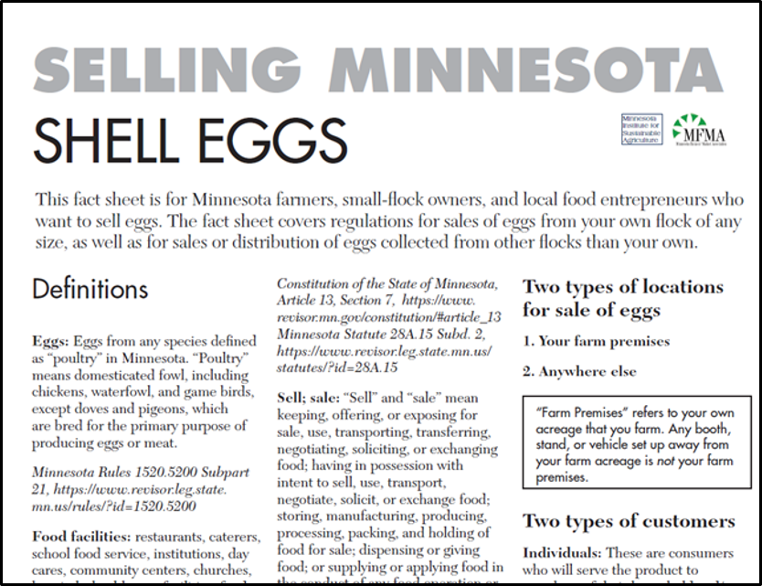
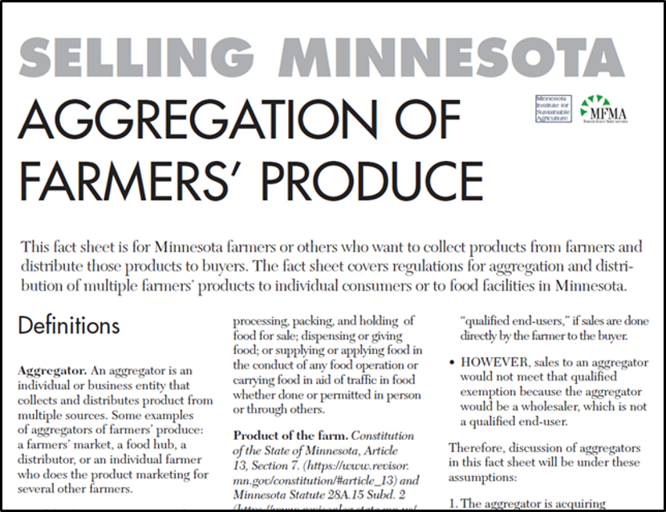
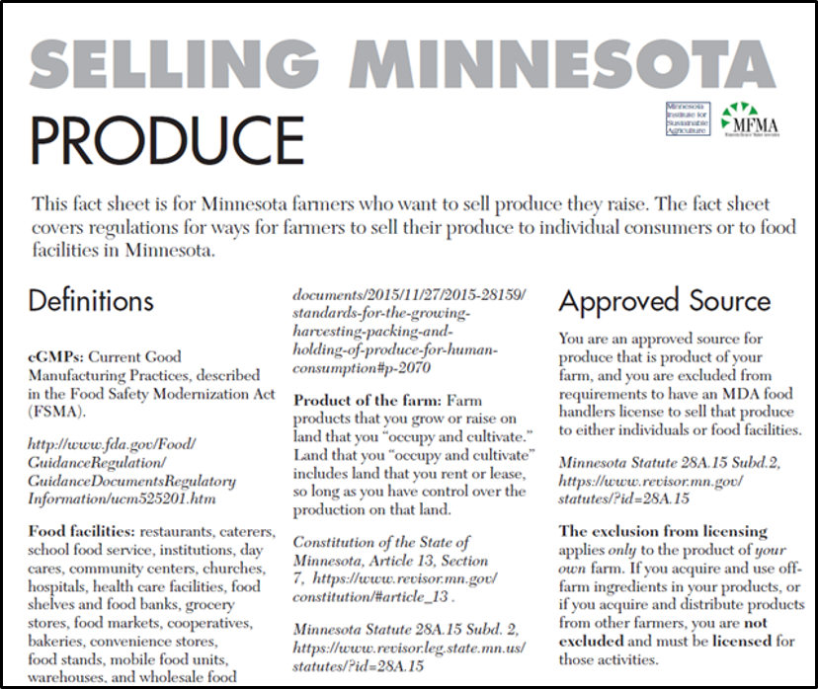
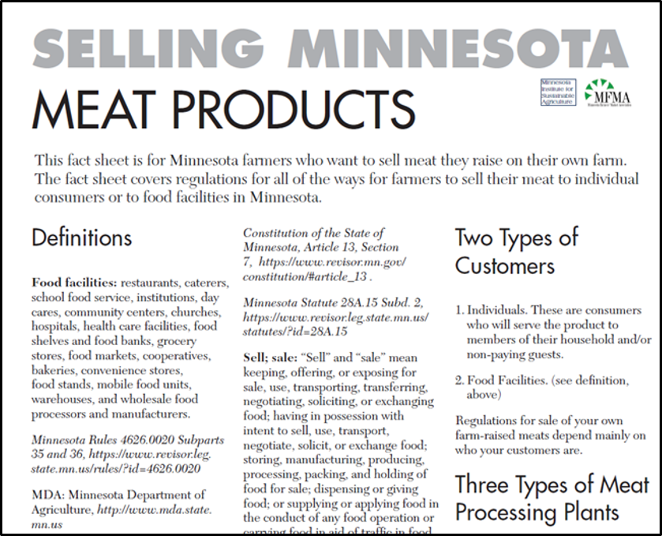
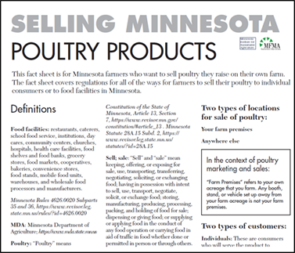
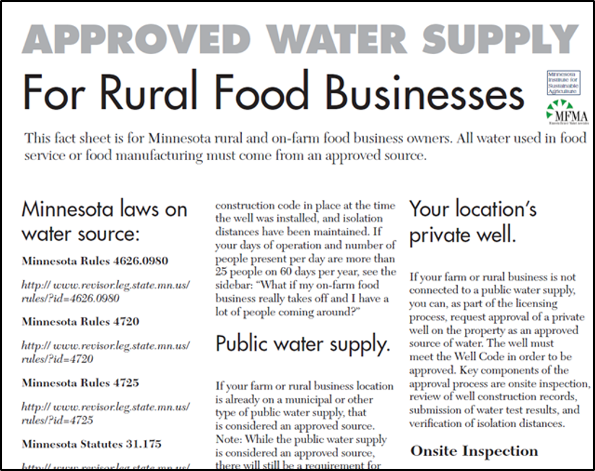
Publications
Reference Materials For Farmers:
http://www.misa.umn.edu/publications
13
Notes:
This series of publications covers in great detail all of the legal pathways for farmers to sell their meat, poultry, eggs, and produce. These were created in close consultation with MDA and MDH regulatory staff.

Slide 14
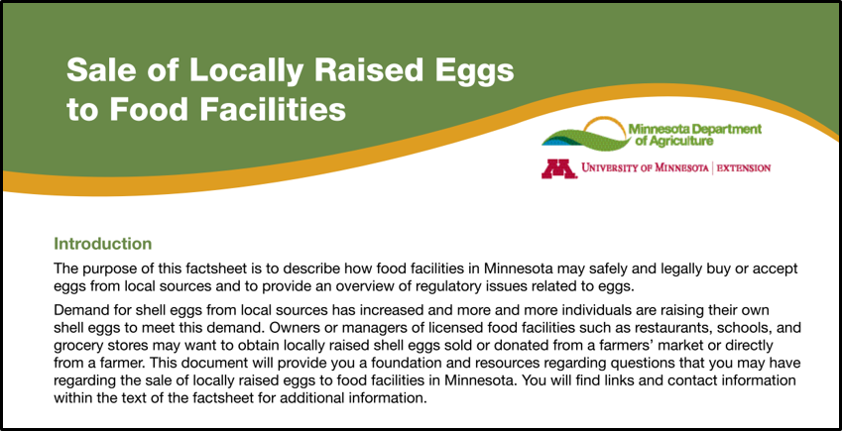
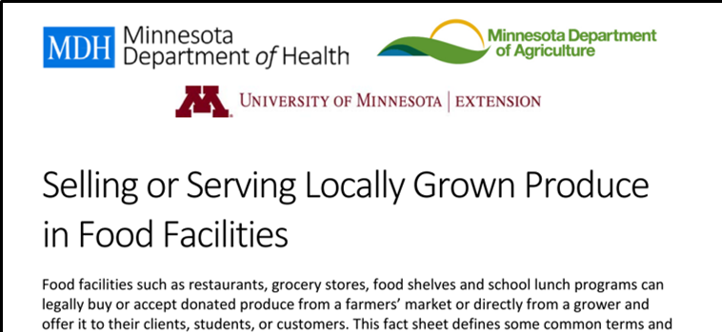
Reference Materials For Buyers:
Notes:
These MDA publications complement the Selling Minnesota guides. They cover the same products and laws, but these are intended for the buyers. They talk about approved sources of products, and only cover the legality of farmer sales to food facilities.
Food from Farms is a toolkit for local sourcing from multiple farmers. It is based on a Farm to School program, but is adaptable to other institutions, organizations, or businesses.

Slide 15
Reference Materials: Foraging
Notes:
Anyone who wants to pick and sell wild mushrooms must take an accredited mushroom identification course, offered in MN by the MN Mycological Society. The new Minnesota Food Code that took effect January 1, 2019 requires that sellers of wild mushrooms to food facilities must have certification of having taken an approved mushroom identification course that includes use of actual specimens in the training. This is a new requirement and people who got previous training that didn’t include the actual specimens must re-take it.

Slide 16
Reference Materials: Cottage Food
Notes:
Cottage Food resources – there are many. If you want to do Cottage Food, there is a lot of support.

Slide 17
Reference Materials: Other Products
https://www.mda.state.mn.us/food-feed/what-raw-milk
https://www.mda.state.mn.us/food-feed/pet-food-program
Notes:
Milk is a unique product in terms of the law. We’ll talk about why that is a bit later. The MDA has this fact sheet about raw milk sales.
What if you sell the raw milk as “pet food?” Minnesota has a pet food law and license requirement. The license is $75 per year. You need to provide an annual list with labels of pet food or pet treat products that are sold in 10-lb. or smaller packages.

Slide 18
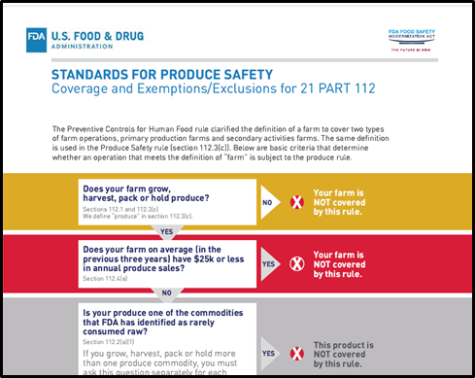
Reference Materials: FSMA Produce Safety Rule
Notes:
FDA’s chart of exclusions and exemptions for the FSMA Produce Safety Rule. The MDA has a Produce Safety Program that is implementing the new law. Farmers who want to check if they are in compliance with FSMA can get a free on-farm readiness review.
U of MN Extension has extensive information about produce safety and how to create an on-farm food safety plan.

Slide 19
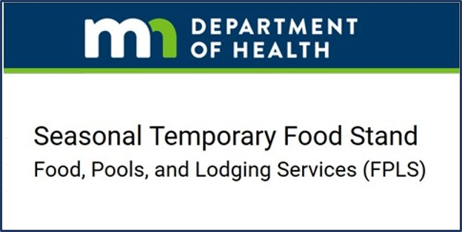
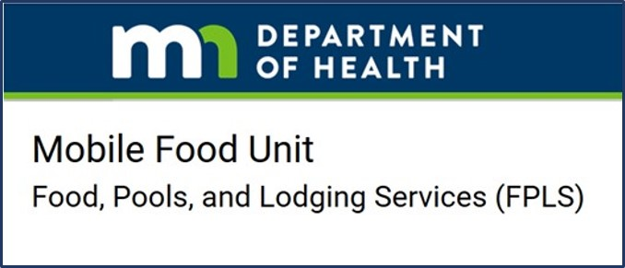
Reference Materials: Food & Beverage Service
Notes:
MN Department of Health handles licensing for food & beverage service businesses, like restaurants. The Special Event Food Stand license is a popular one for on-farm events and festivals. There are other options for temporary or mobile food businesses.

Slide 20
Reference Materials: Food & Beverage Service
http://www.misa.umn.edu/publications
Notes:
Come & Get It! What You Need to Know to Serve Food on Your Farm has information about all of the food & beverage service licenses. It was written for on-farm food service, obviously, but farms do not have special status when it comes to food service. The same regulations apply to all food & beverage service, so this publication works for non-farm businesses as well.

Slide 21
For Food Manufacturers
https://extension.umn.edu/food-safety/food-processors
Notes:
For licensed food processors making pickles or other acidified foods, it used to be very difficult to get the necessary training, certification, and approval of your process in Minnesota. People had to travel out of state. Now U of MN Extension and the Food Science & Nutrition Department are offering the acidified foods training in Minnesota, so that’s a great resource to have.
MN Department of Agriculture does the licensing for food manufacturing. More information about the licensing is on the MDA website.
MISA’s Commercial Kitchen Guide is a little out of date because it still mentions the Pickle Bill, and that got rolled into the Cottage Food Law in 2015. The basic information is still good.

Slide 22
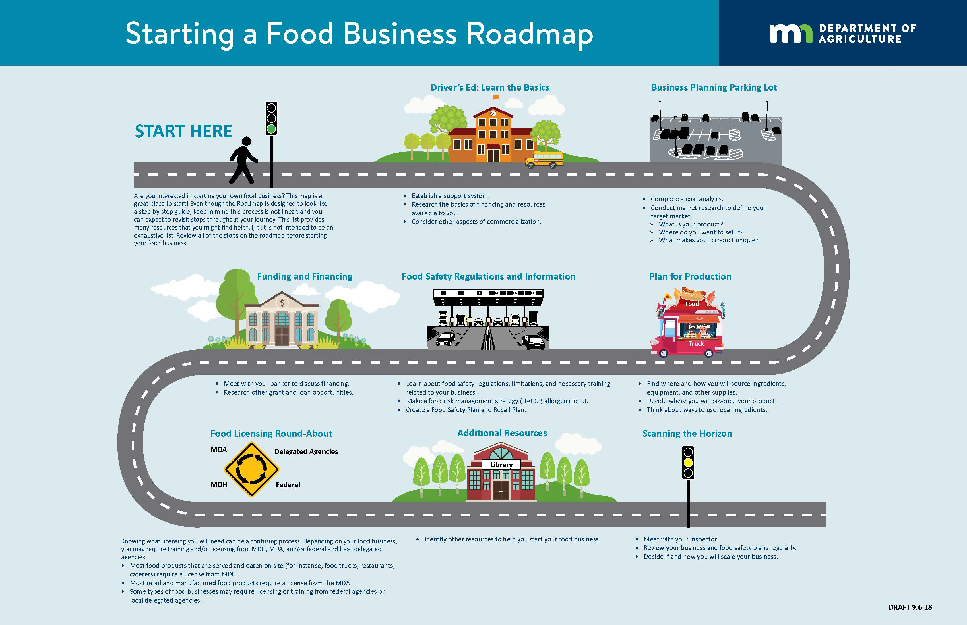
Reference Materials: For Food Businesses
Notes:
Starting a Food Business Roadmap – housed by MDA, developed by a group of organizations that work with farmers and food start-ups. Pictorial version of the steps needed to start a licensed food business, with references for each “stop” on the road.

Slide 23
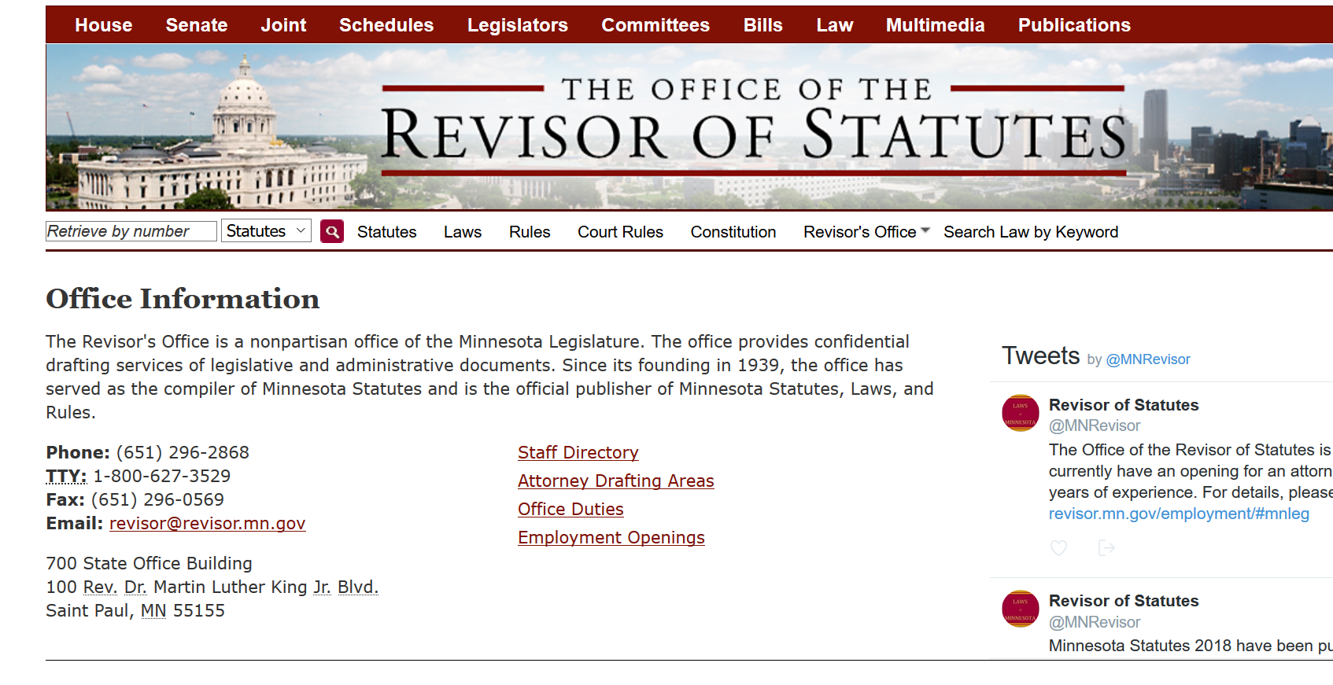
Publications
23
Notes:
Revisor of Statutes website has all the text for all the statutes and Rules, as well as full text of the State of MN Constitution. Sometimes there is a need to go back to the actual language of the law to be certain of what it says. You can find all of that here.

Slide 24
The landscape of food regulation: federal, tribal, state, local (statute & rule)
Notes:
The interplay of federal, tribal, state, and local laws is complex and confusing. We’re going to start here because it gives you a basis to understand why and how we have the food laws that we do.

Slide 25
Landscape of Food Regulation
Food:
"Food" means every ingredient used for, entering into the consumption of, or used or intended for use in the preparation of food, drink, confectionery, or condiment for humans or other animals, whether simple, mixed, or compound; and articles used as components of these ingredients.
M.S. 34A.01 Subdivision 4 https://www.revisor.mn.gov/statutes/cite/34A.01
Notes:
*** Have someone in the audience read this out loud.
Food means anything intended for human consumption. Things that may get consumed that were never intended to be consumed are not defined as food. If your baby is sitting in the sandbox and eating fistfuls of dirt, that is not “food.”

Slide 26
Landscape of Food Regulation
Sell/Sale:
"Sell" and "sale" mean keeping, offering, or exposing for sale, use, transporting, transferring, negotiating, soliciting, or exchanging food; having in possession with intent to sell, use, transport, negotiate, solicit, or exchange food; storing, manufacturing, producing, processing, packing, and holding of food for sale; dispensing or giving food; or supplying or applying food in the conduct of any food operation or carrying food in aid of traffic in food whether done or permitted in person or through others.
M.S. 34A.01 Subdivision 12 https://www.revisor.mn.gov/statutes/cite/34A.01
Notes:
*** Have someone in the audience read this out loud.
Any time a food product changes hands in Minnesota counts as a “sale,” whether or not money is involved. This language covers just about everything except passing a dish around the family dinner table.

Slide 27
Landscape of Food Regulation
Definitions:
Food = Every ingredient involved in something humans will eat or drink
Sell/Sale = Any time food changes hands in any way
Notes:
Re-cap of these definitions

Slide 28
Landscape of Food Regulation
Definitions:
Person = Any individual, firm, partnership, cooperative, society, joint stock association, association, company, or corporation and includes any officer, employee, agent, trustee, receiver, assignee, or other similar business entity or representative of one of those entities.
Individual = An actual flesh-and-blood human being
M.S. 34A.01 Subd. 10 https://www.revisor.mn.gov/statutes/cite/34A.01
Notes:
“Person” has a definition in Minnesota Statute. It includes corporations and other businesses that are legal “persons.” The word “individual” is not defined separately in statute but the common understanding of the term is as described on the slide.

Slide 29
Landscape of Food Regulation
Phrases not defined in Minnesota statute:
“Regularly Engaged in Food Business”
“Community Event”
“Point of Sale”
*** If you run into unknowns, there is help! We’ll talk about the Food Innovation Team in a bit.
Notes:
These phrases are used in MN statute, but not defined by statute – so they are grey areas.

Slide 30
Landscape of Food Regulation
Abbreviations:
CFR = Code of Federal Regulations
CGMP = Current Good Manufacturing Practices
PMO = Pasteurized Milk Ordinance
Notes:
You’ll see these abbreviations pop up in later slides.

Slide 31
Landscape of Food Regulation
More Terms:
Approved = MN Rules 4626.0020 subpart 4
Exemption = given in statute
Exclusion = carved out of statute
Notes:
Approved sources of food for food businesses and food facilities to buy are defined in Minnesota Rule. Product of the Farm is included as an approved source. Cottage Food Law and the Food Product Sampling & Demonstration Law are exemptions. They are specifically granted by statute. Exclusions are cases where the statute doesn’t apply. Product of the Farm is an exclusion from the statute requiring licensing for the production and handling of food.

Slide 32
Landscape of Food Regulation
Federal Law:
USDA
Pure Food and Drug Act (1906) Meat Inspection Act (1906)
Poultry Products Inspection Act (1957)
Notes:
The framework of federal rules is the basis for state-level statutes & Rules. These laws are not new. Federal, state, and local regulations interact. States can be stricter, but not less strict, than federal law.
The Meat Inspection Act and the Pure Food and Drug Act were passed in response to Upton Sinclair’s book, The Jungle; and to exposes written by other “muckraking” journalists around the same time. Americans demanded protection of the food supply.

Slide 33
Landscape of Food Regulation
Federal Law: FDA
Pasteurized Milk Ordinance (1924)
Food, Drug, and Cosmetic Act (1938) Food Safety Modernization Act (2011)
Notes:
More federal laws. The PMO was enacted because of tuberculosis. Cows had it, and were transmitting it to humans through milk. Pasteurization took care of it. Pasteurization started under the 1906 Pure Food and Drug Act, but was expanded and strengthened by the PMO. It’s one of the great public health successes of the 20th century.
The most recent federal food law, the Food Safety Modernization Act, was passed partially in response to nationally-reported outbreaks of illness associated with food products. It became clear that governments did not have the tools necessary to proactively ensure safety of the food supply, and was limited to responding to illness outbreaks only after they occurred.

Slide 34
Landscape of Food Regulation
Food Safety Modernization Act (2011)
7 parts:
* Produce Safety * Preventive Controls for Human Food
* Preventive Controls for Animal Food
* Sanitary Transportation of Food
* Foreign Supplier Verification
* Accredited Third-Party Certification
* Intentional Adulteration of Food
Notes:
There are actually 7 Rules under FSMA. We’re mostly concerned with two of them: Produce Safety Rule and Preventive Controls for Human Food Rules.
The other 5 are: Preventive Controls for Animal Health, Sanitary Transportation, Foreign Supplier Verification, Accredited Third-Party Certification, and Intentional Adulteration.

Slide 35
Landscape of Food Regulation
Creamery Journal, 1907 – Wheeler McMillan
Inspector Under the Act
“Where are you going, my pretty maid?”
I’m going a-milking, sir,” she said.
“Dear maiden, I’d like to disclose the fact,
That I’m an inspector under the Act.
So pray remain, for I want to know
A thing or two before you go.
Nay, pretty maiden, you must not weep;
How far away are the pigs you keep?
And what percentage of butter-fat
Does your moo-cow yield? Pray tell me that.
And how is the health of your pretty pet;
Has it anthrax, cancer, blackleg, garget?
Has your sister measles or whooping cough;
Is the water clean in the drinking trough?
I pray thee answer these questions of fact,
For I’m an inspector under the Act.
With the fierce bacilli also I cope
By means of my powerful microscope.
Excuse me, I must examine your hand,
Purely official, you understand.”
--accessed from Living History Farms website https://www.lhf.org/2011/09/pasterization-and-regulation/
Notes:
These federal laws are not new. It was a major change and challenge for farmers to deal with at the time, and it still is. This poem pokes at the interaction between farmers and inspectors back when inspection was a brand-new concept, but it’s interesting how much this dynamic is still at play. The inspector is asking about things like the health of the animals and the water in the drinking trough and whether there is illness in the milking-maid’s home and the condition of her hands, all things that she may not thought of as connected to food safety, and assumed were none of the government’s business.

Slide 36
Landscape of Food Regulation
Federal Law:
USDA:
meat, poultry, eggs
MN can be stricter than, but not less strict than USDA
Stricter in MN:
“Amenable” farm-raised game species
Fewer types of exemptions for on-farm poultry processing
Notes:
Examples where MN is stricter:
The USDA considers farm-raised game species like bison, elk, rabbit to be “non-amenable” to inspection, and says inspection is voluntary for sale of products from those animals. Minnesota says that farm-raised game species are still meat and are “amenable” to inspection, so processing and sale of products from these animals in MN requires continuous inspection. Continuous inspection means the inspector is there on every day of operations. The inspector looks at live animals before they are slaughtered, looks at the organs and carcasses after they are slaughtered, and looks at the meat processing areas of the plant.
USDA has four poultry processing exemptions that could be used by farmers. Minnesota only allows two of those and has tighter restrictions on allowed buyers for the poultry processed under an exemption.

Slide 37
Landscape of Food Regulation
Federal Law:
FDA:
fish, shellfish, snails, crickets, milk, all other food…
…unless a wholesale food product contains more than 2% meat. Then it’s USDA.
Notes:
The FDA’s regulatory authority is delegated to state departments of agriculture or departments of health. In the case of milk in MN, the underlying law is in FDA’s “house,” but in MN that authority is delegated to the MN Department of Agriculture.

Slide 38
Landscape of Food Regulation
Crossing State
Lines?
FDA or USDA
State Statute
- no variances
State Rule - variances allowed
Minnesota Rule 4626:
Minnesota Food Code
Notes:
You probably don’t have to personally interact with agencies at every level. Most federal food regulations are implemented at the state level by MDA or MDH. You’ll have one regulatory point person who is under the jurisdiction of either MDA or MDH.
Once products cross state lines, they are in interstate commerce, which is regulated by USDA or FDA.
Explain again the difference between statute and rule: there can be variances to Rule. The Minnesota Food Code is a Rule, so there can be variances.

Slide 39
Landscape of Food Regulation
Sovereign Nations
In general (may be exceptions):
Trust Land: Activities subject to tribal law
Fee Land & Privately Owned: Activities subject to federal, state, and local laws
Gray area: When a food product is made on trust land but sold elsewhere
Notes:
The interactions between treaty rights, tribal law, and federal and state law are very complex.
Trust land is land belonging to a tribe and held in trust by the federal government.
Fee land is land that may be owned by a tribe or by individual tribal members, but is not entered into trust.
Activities done by tribal members on trust land are generally subject to tribal law. Activities done by tribal members on fee land are generally subject to the applicable federal, state, and local laws. Activities that cross over from tribal trust land to other places are handled on a case-by-case basis. Specific treaty provisions and details of federal law may alter these generalities in some cases.

Slide 40
Landscape of Food Regulation
Sovereign Nations
Model Ag & Food Code:
https://www.tribalfoodcode.com/
Notes:
Tribal nations can have their own food code. Janie Hipp, Chickasaw, Director of the Indigenous Food and Agriculture Initiative at the University of Arkansas Law School, and her colleagues have developed a model food and agriculture code for use by tribal nations.

Slide 41
Landscape of Food Regulation
Local Ordinances
- variances
- conditional use permits - zoning
Best Practices
- GAP
Notes:
Local governments with delegated authority from MDA or MDH can have their own food ordinances, which may be stricter than the state’s but cannot be less strict. If a local government doesn’t have delegated authority for food, it can still have zoning. Zoning can trip up food businesses that may be legal according to food laws, but may not be allowed in a certain area according to local zoning. All zoning is local. Your recourse for a zoning issue is to appeal to the governing body of the local jurisdiction.
Beyond regulation, there are voluntary best practices. Even if you are not legally required to implement a food safety practice, doing it voluntarily can help protect you from liability.

Slide 42
Landscape of Food Regulation
License vs. Inspection
Legal authority of MDA to inspect: M.S. 31.04
Legal authority of MDA to enforce: M.S. 34A.04
Legal authority of MDH to inspect and enforce:
M.S. 157.20
Inspection authority flows to delegated authority if specified in the contract for the delegated authority

Slide 43
Landscape of Food Regulation
M.S. 31.04 For purposes of enforcement of the Minnesota Food Law, the commissioner, or any of the commissioner's authorized agents, is authorized upon presenting appropriate credentials to the owner, operator or agent in charge:
(1) to enter at reasonable times any factory, warehouse, or establishment in which food is manufactured, processed, packed or held for introduction into commerce or after such introduction or to enter any vehicle being used to transport or hold such food in commerce;
(2) to inspect at reasonable times and within reasonable limits and in a reasonable manner such factory, warehouse, establishment or vehicle and all pertinent equipment, finished and unfinished materials, containers and labeling therein; and to obtain samples necessary to the enforcement of the Minnesota Food Law; and
(3) to have access to and to copy all records of carriers in commerce showing the movement in commerce of any food or the holding thereof during or after such movement, and the quantity, shipper and consignee thereof; provided, that evidence obtained under this clause shall not be used in a criminal prosecution of the person from whom obtained; and provided, further, that carriers shall not be subject to the other provisions of the Minnesota Food Law by reason of their receipt, carriage, holding, or delivery of food in the usual course of business as carriers.
Notes:
Purpose of inspection authority – MDA can go look at things; but won’t look at everything unless they have a reason to. Can’t go onto adjacent properties.
Cottage Food producers need to know the MDA can go into their kitchen, and farmers need to know the MDA can go onto their farm. The MDA won’t unless there’s a complaint – but if there is a complaint, the MDA will use their inspection authority and enforcement authority.

Slide 44
Landscape of Food Regulation
M.S. 34A.04 Subdivision 1.Enforcement required.
(a) The commissioner shall enforce this chapter and chapters 28, 28A, 29, 30, 31, 31A, and 34. To carry out the enforcement duties under these chapters, the commissioner may, upon presenting appropriate credentials, during regular working hours and at other reasonable times, inspect premises subject to the commissioner's enforcement and licensing authority; require information from persons with information relevant to an inspection; and inspect and copy relevant papers and records, including business records.
Notes:
Purpose of regulatory authority – if MDA finds evidence of unsafe food conditions, they are obliged to go into the facility to do enforcement

Slide 45
Landscape of Food Regulation
M.S. 157.20
Subdivision 1.Inspections.
It shall be the duty of the commissioner to inspect, or cause to be inspected, every public pool, food and beverage service establishment, hotel, motel, lodging establishment, or resort. For the purpose of conducting inspections, the commissioner shall have the right to enter and have access thereto at any time during the conduct of business.
Subdivision 3.Orders.
When, upon inspection, it is found that the business and property so inspected is not being conducted, or is not equipped, in the manner required by the provisions of this chapter or the rules of the commissioner, or is being conducted in violation of any of the laws of this state pertaining to the business, it is the duty of the commissioner to notify the person in charge of the business, or the owner or agent of the buildings so occupied, of the condition found and issue an order for correction of the violations. Each person shall comply with the provisions of this chapter or the rules of the commissioner. A reasonable time may be granted by the commissioner for compliance with the provisions of this chapter.
Notes:
Purpose of regulatory authority to inspect and enforce – if Minnesota Department of Health or its delegated authorities find evidence of unsafe food conditions in food and beverage service, they are obliged to see the condition corrected.

Slide 46
Landscape of Food Regulation
Keeping our presentation on track:
Some things are relevant
to Local Food Businesses
But we’re not going to talk about them

Slide 47
Landscape of Food Regulation
Taxes?
Visit MN Dept of Revenue Website to find fact sheets
www.taxes.state.mn.us
Fact Sheet # 148: Selling Event
www.revenue.state.mn.us/businesses/sut/ factsheets/FS148.pdf
Notes:
This fact sheet is for event organizers. It covers what your obligations are re: exhibitors at your event.

Slide 48
Landscape of Food Regulation
Taxes?
Fact Sheet #102D
Industry Guide: Prepared Food
www.revenue.state.mn.us/businesses/sut/ factsheets/FS102D.pdf
Notes:
Taxable: Food where two or more ingredients are mixed or combined for sale by the seller as a single item. This fact sheet goes into detail on that.

Slide 49
Landscape of Food Regulation
Insurance? Business Structure?
Find info for farm-based enterprises: Secretary of State
Farm Commons
FLAG
Ag Law Ctr @ Drake University
Public Health Law Center/Mitchell-Hamline
Great Lakes Indigenous Law Center
Notes:
Insurance and business structure are critically important for food businesses and you should spend some time researching them, but they are separate from food law so we’re not going to cover them in this presentation. There are good resources available. The links to these resources are included in the binders and handouts.

Slide 50
Quiz:
When were the first federal food laws enacted?
What’s the most recent federal food law?
What was the main original reason for pasteurizing milk?
What is food?
What food exchanges are not considered a “sale?”
Notes:
Answers:
First federal food laws were enacted in 1906.
Most recent federal food law is FSMA, in 2011. FSMA has 7 Rules.
Original reason for pasteurization of milk: tuberculosis was spreading from cows to humans via milk.
Food: anything intended for human consumption
Not considered sale: private exchange of food around the family dinner table or similar answer

Slide 52
Does Safe = Licensed?
Does Licensed = Safe?
Not always!
Locally-grown product of the farm is an approved source of food without being licensed.
Notes:
Add examples of licensed food that gets recalled or that makes people sick. For example, the Salmonella outbreak from peanut butter a few years ago. Conversely, product of the farm can be very safe but not licensed..

Slide 53
Exclusions from Licensing

Slide 54
Exclusion from Licensing
Product of the Farm
State of Minnesota Constitution, Article 13, Section 7
MN Statute 28A.15 Subd. 2: https://www.revisor.mn.gov/statutes/cite/28A.15

Slide 55
Product of the Farm
Product of the farm is NOT an exclusion from food safety requirements!
Follow CGMPs
Adequate facility
* Not a private residence
* Not used for personal activities
Notes:
Use “private residence” instead of home. If you have a commercial-grade kitchen facility on your property with separate entrance from your home, that can be used for product of the farm processing – BUT you cannot also use it for your regular preparation of meals for your private household.
Cottage Food – takes the GMP rules, facilities requirements, 4626 is off the table.
Meat for sale can’t be in the same freezer as your personal meat supply
Commercial kitchen attached to home and used for commerce can’t also be used for personal cooking.

Slide 56
Product of the Farm
People can sell their own product of the farm or garden to any buyer, including food facilities, with no license.
Has to be from their owned or rented property (any size or configuration)
No off-farm ingredients added
Cultivated mushrooms grown in a growth chamber in seller’s basement = product of the farm.
Herbs grown in a 6’ x 6’ raised bed in seller’s backyard = product of the farm.
Notes:
Cultivated mushrooms grown in a growth chamber in someone’s basement = product of the farm. Herbs grown in a 6’ x 6’ raised bed in someone’s backyard = product of the farm.
If you are a restaurant that has a garden on site to supply some of your product, that is not a license exclusion. The restaurant is licensed, and growing some of their own product is one of their activities under their license.

Slide 57
Product of the Farm
Meats with no added ingredients
Poultry products with no added ingredients
Shell eggs
Fruits
Vegetables
Edible flowers
Cultivated Mushrooms
Herbs
Nuts
Grains
Dry beans
Honey
Maple syrup
Wild foraged foods from own property
What’s missing from this list? DAIRY. Dairy products have additional facilities and inspection requirements under the Pasteurized Milk Ordinance (PMO)
Notes:
What’s missing from this list? DAIRY. Dairy products are highly perishable and aren’t frozen for sale like meats. Dairy products have additional facilities and inspection requirements. What about wild mushrooms? Those can qualify as product of the farm if harvested on the seller’s owned or leased property, BUT the seller must be certified with the MN Department of Agriculture as trained in wild mushroom identification.

Slide 58
Product of the Farm
Meats with no added ingredients
Poultry products with no added ingredients
Shell eggs
Why are these items blue?
Because regulations for sale of these items depend on your buyer and on where you sell.
Notes:
What’s missing from this list? DAIRY. Dairy products are highly perishable and aren’t frozen for sale like meats. Dairy products have additional facilities and inspection requirements. What about wild mushrooms? Those can qualify as product of the farm if harvested on the seller’s owned or leased property, BUT the seller must be certified with the MN Department of Agriculture as trained in wild mushroom identification.

Slide 59
Product of the Farm
Meats with no added ingredients
Poultry products with no added ingredients
Shell eggs
If you are selling to a food business:
the meat or poultry must be processed under inspection (USDA or Minnesota Equal-To)
shell eggs have grading, candling, & labeling requirements.
Notes:
What’s missing from this list? DAIRY. Dairy products are highly perishable and aren’t frozen for sale like meats. Dairy products have additional facilities and inspection requirements. What about wild mushrooms? Those can qualify as product of the farm if harvested on the seller’s owned or leased property, BUT the seller must be certified with the MN Department of Agriculture as trained in wild mushroom identification.

Slide 60
Product of the Farm
Meat & Poultry
Locally raised meats and poultry are legal for food facilities to use if slaughtered and processed under continuous (daily) inspection. Two options:
USDA (can cross state lines)
Minnesota Equal-To (can be sold within MN)
http://misadocuments.info/LFAC_local_meat.pdf
http://misadocuments.info/LFAC_local_poultry.pdf
Notes:
Within Minnesota, USDA and Minnesota Equal-To inspection are equally valid for sale of meat and poultry to food facilities. The difference is MN Equal-To meat cannot be shipped across state lines.

Slide 61
Product of the Farm
Meat & Poultry
If you buy an animal out of the sales ring at a livestock auction
… and take it straight to a butcher for your meat sales
…is that really product of your farm?
Notes:
In some states, Ohio for example, you have to own and feed an animal for minimum of 30 days to be considered “your own animal.” In Minnesota, the 30 days is not in statute but it has been used by the MDA as a guideline to determine whether someone is considered a “livestock dealer” rather than a farmer.

Slide 62
Product of the Farm
Meat & Poultry
Livestock dealers are required to have a license to buy & sell animals. The dealer license is not required for:
“…persons engaged in the business of farming, when purchasing livestock for breeding or herd replacement purposes or feeding programs, and when selling the livestock they have owned and raised, fed out or fattened for slaughter in their specific farming program.” M.S. 17.03 Subdivision 7(b)
Notes:
If you are frequently buying and re-selling animals, you could come under the Livestock Dealer law. If you are buying animals and re-selling them for meat with a short turnaround time, you may be asked to demonstrate your ownership of those animals, length of time you have owned them, and how they were raised in your specific farming program. There could potentially be contract-type arrangements that are legitimate.

Slide 63
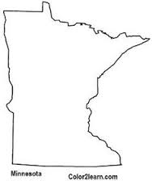
Product of the Farm
Meat & Poultry
USDA inspection “bugs”
Minnesota
Equal-To
Inspection
“bug”
Minnesota
Inspected
and
Passed
#9999
Notes:
The first circle is for USDA red meat. The second circle has a “P” in front of the number, which refers to poultry. The number identifies the facility. Red meat and poultry processed at a Minnesota Equal-To plant get the same mark of inspection. The outline of Minnesota will include a number that represents the processing plant. Red meat and poultry can’t be processed in the same facility at the same time. Either there are separate facilities, or separate days with a clean break in between.

Slide 64
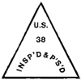
Product of the Farm
Meat & Poultry
“Non-amenable” species:
bison
cervidae (elk, deer)
rabbit
guinea pig
pheasant
Minnesota
Inspected
and
Passed
#9999
Notes:
The USDA triangle is for “non-amenable” (game species) farm-raised animals processed under voluntary inspection at a USDA plant. In Minnesota, farm-raised game animals are defined as “amenable” to inspection and receive the same mark of inspection as domestic species. Wild-harvested wild game cannot be sold in commerce because it doesn’t get a pre-slaughter inspection. May be exceptions in some tribal settings. Farm-raised dangerous animals (elk, bison, bull) can have antemortem inspection by an inspector & inspector witnesses the whole process of killing and transport to the plant. Animal carcass must be left intact & gotten to plant within limited period of time.

Slide 65
Product of the Farm
Meat & Poultry
Kosher or Halal Processing
Religious bodies must approve the slaughterer to conduct slaughter according to their requirements.
The slaughterer must submit an application to MDA or USDA that includes a certificate of approval from their religious body.
The slaughterer must pass a visual inspection of their slaughter technique on the kill floor of a processing plant. They must be able to accomplish humane slaughter with their technique.
Notes:
There is zero tolerance for inhumane slaughter. The slaughterer approved by a religious body must be able to simultaneously sever trachea, jugular vein, and carotid artery to allow for rapid bleed-out that renders the animal insensate.
Labeling is the same as other meats – the same inspection bugs are used – but with the addition of a mark of kosher or halal approval.

Slide 66
Product of the Farm
Meat & Poultry
Wild-harvested game cannot be sold in commerce because it doesn’t get a pre-slaughter inspection.*
*May be exceptions in some tribal settings.
Notes:
Farm-raised dangerous animals (elk, bison, bull) can have antemortem inspection by an inspector & inspector witnesses the whole process of killing and transport to the plant. Animal carcass must be left intact & gotten to plant within limited period of time.

Slide 67
Product of the Farm
Meat & Poultry
Farm-raised dangerous animals (elk, bison, bull) can have antemortem inspection on-farm. The inspector witnesses the whole process of killing and transport to the plant. Animal carcass must be left intact & delivered to plant within a limited period of time (1 hr).
Notes:
This isn’t for all bulls, bison, or elk; only ones that are particularly aggressive or dangerous. This also doesn’t work if the farm is a long distance from the processing plant, so that it would take longer than an hour to transport the carcass. Mobile inspected processing units may be an option. There is a new USDA-inspected mobile processor in MN, based in Bemidji: Stittsworth Meats.

Slide 68
Product of the Farm
Meat & Poultry
Donated meat has to be eligible to be sold to a food facility;
UNLESS it’s the Venison Donation Program
Venison donation program – set up through DNR with cooperation from MDA specifically for donation to nonprofit food assistance programs
M.S. 17.035 venison donation
Notes:
Processing plants have to apply to be venison donation locations and get approved by MDA. The meat is all sent to a central location to be X-rayed to check for bullet fragments before being distributed back to food banks, food shelves, and feeding programs.

Slide 69
Product of the Farm
Meat & Poultry
OR donation of traditional Native American foods to a food service program in a public facility
Wild-harvested wild game or fish can be donated to food service programs that serve primarily (more than 50%) Native Americans.
It is the food service’s responsibility to verify the donated game is wholesome and was handled in a sanitary manner.
Notes:
This provision was included in the 2014 Farm Bill, and retained in the 2018 Farm Bill. 25 Code of Federal Regulations 1685.
https://www.law.cornell.edu/uscode/text/25/1685 https://fns-prod.azureedge.net/sites/default/files/cn/SP42_CACFP19_SFSP21-2015os.pdf

Slide 70
Product of the Farm
Meat & Poultry
OR donation of wild-harvested wild game to a registered charitable organization.
The donor of the game must provide a receipt documenting the gift of the game to the receiving organization
The game meat must be received and processed in an MDA-licensed facility; and handled, stored, prepared, and served according to all sanitary requirements in licensed facilities.
Notes:
This provision is pieced together from several Minnesota statutes and Rules that relate to gifting of wild game, registration of charitable organizations, and facility and process requirements for meat. See Minnesota Rules 4626.0160 subpart (C) for links to the relevant statutes and Rules: https://www.revisor.mn.gov/rules/4626.0160/

Slide 71
Product of the Farm
Shell Eggs
Locally raised shell eggs are legal for food facilities to use. Eggs are product of the farm if sold by the farmer who owns the egg-layer flock, and can be handled and sold by others with the proper licensing from MDA and/or registration from USDA.
http://misadocuments.info/LFAC_local_eggs.pdf
Notes:
Make sure to note that licensing is needed if someone starts selling someone else’s eggs.

Slide 72
Product of the Farm
Shell Eggs
Health care facilities may be an exception. Pasteurized eggs are required for some uses at health care facilities because their patients or residents are defined as “highly susceptible populations.”
http://misadocuments.info/LFAC_local_eggs.pdf
Notes:
Health care facilities, nursing homes, long-term care facilities are regulated by a different division within the MN Department of Health instead of the Food, Pools, and Lodging division that regulates all other food & beverage service.

Slide 73
Product of the Farm
Shell Eggs
Small Flock Egg Producer Registration Form
http://mda.state.mn.us/sites/default/files/2018-05/ag02433eggx_0.pdf
Notes:
Registration is voluntary, but provides documentation that you are an approved vendor. There is no registration fee, and the form is one page.

Slide 74
Questions about meat, poultry, or shell egg sales to food facilities?

Slide 76
Product of the Farm
Meats with no added ingredients
Poultry products with no added ingredients
Shell eggs
If you are selling to individuals at a farmers’ market:
The meat must be processed under inspection
The poultry can be processed under inspection OR on the farm in an approved facility, and labeled as PL-exempt.
shell eggs have grading, candling, & labeling requirements.
Notes:
PL-exemption: not the same as the 1,000-bird exemption. PL-exemption can go up to 20,000.
Right of customer to inspect a farm, a butchering process? This is a face-to-face transaction. The buyer takes on the responsibility of verification of safety.

Slide 77
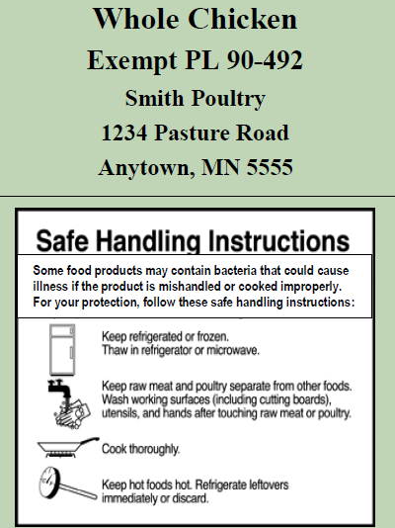
Product of the Farm
Farmers can process chicken on their own farms, without a license, under approved sanitary conditions, for sale to individual end consumers.
Notes:
Farmers can process chicken on their own farms, without a license, for sale to individual consumers. This type of labeling would be okay on a chicken for sale to an individual farmers’ market customer, but cannot be purchased by a grocery store, restaurant, school, hospital, etc.
PL stands for Public Law. This was part of the federal Wholesome Poultry Products Act of 1957.
Approved sanitary conditions will mean an indoor facility with approved floor, wall, and ceiling finishes: smooth, cleanable, durable, non-porous.

Slide 78
Product of the Farm
Storage & Transport Requirements for meat, poultry, and eggs at farmers’ markets:
Meat & Poultry – frozen, 0ºF -- fresh, 41ºF + date-marking
Shell Eggs – 45ºF
Notes:
Commercial-grade freezers and refrigerators are not required if you are selling Product of the Farm. If you have a license, such as Retail Food Handler, your freezers must be commercial-grade but are not required to be ANSI certified if they are for maintaining temp of frozen product. You can use a cooler with ice to hold shell eggs cold, but must be able to maintain the required temperature. Rule of thumb: 4 hours outside of mechanical refrigeration.

Slide 79
Product of the Farm
Questions about meat, poultry, or shell egg sales at farmers’ markets?

Slide 81
Product of the Farm
Meats with no added ingredients
Poultry products with no added ingredients
Shell eggs
If you are selling to an individual customer who comes to your farm:
Meat packages must have been processed under continuous inspection
Poultry can be inspected, or processed on the farm
Eggs need not be candled, graded, or labeled
Notes:
The customer must actually set foot on your farm premises. The customer’s personal observation of your farm takes the place of agency inspection. Freezers used to hold frozen meat or poultry must be able to hold a temp of zero degrees F or below, but are not required to be ANSI certified.

Slide 82
Product of the Farm
Custom-Exempt Sales
Meat or poultry, sold prior to slaughter and processed at a licensed & permitted Custom-Exempt facility
The customer gives their cutting & processing instructions to the custom-exempt facility.
The customer can choose to have ingredients added such as spices, and special processes such as smoking.
Notes:
Packages will be marked “Not for Sale.” That means what it says. There has been some confusion; some people think that means the processing plant can’t sell the packages of meat but the farmer can. Not true. The farmer’s customer(s) must own the animal before it goes to slaughter. The farmer cannot legally take back packages marked Not for Sale and sell them.

Slide 83
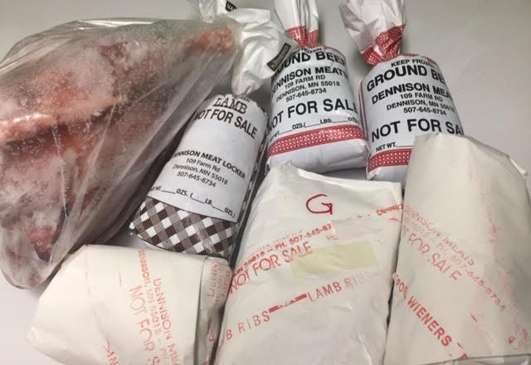
Product of the Farm
Custom-Exempt Sales
Packages go to the customer and are labeled “Not for Sale” or unlabeled.
Notes:
Packages will be marked “Not for Sale.” That means what it says. There has been some confusion; some people think that means the processing plant can’t sell the packages of meat but the farmer can. Not true. The farmer’s customer(s) must own the animal before it goes to slaughter. The farmer cannot legally take back packages marked Not for Sale and sell them. Same with unlabeled packages – those must go back to the owner of the animal and cannot be sold.

Slide 84
Product of the Farm
Wild foraged foods
* Wild Mushrooms can qualify as product of the farm if harvested on the seller’s owned or rented property, BUT the seller must have their certificate of training in wild mushroom identification and be registered with the MN Department of Agriculture.
* Herbs, edible flowers, nuts, other edible plants or portions of plants can qualify as product of the farm if harvested on the seller’s owned or rented property.
Notes:
The certification requirement for wild mushroom sales is for sales to food facilities. It is not a requirement for sales to individuals at farmers’ markets. However, farmers’ markets would be well advised to require this certification in order to reduce their liability risk. The new Minnesota Food Code that took effect January 1, 2019 changed the mushroom certification requirements to require a course in mushroom identification that includes actual, fresh mushroom specimens. Currently the only entity offering such a course in MN is the MN Mycological Society.

Slide 85
Product of the Farm
Wild foraged foods
If you’re harvesting wild foods on land you don’t own or rent, you need a food handler license for the sale of those products.
If public land or public waters, Natural Resources agency permit may be required
(state or tribal)
Notes:
The Natural Resources agency may be the Minnesota DNR, or a tribal government agency.

Slide 86
Processed Product of the Farm?
Notes:
Can product of the farm include processed products?

Slide 87
Product of the Farm
Can include processed fruits & vegetables
2 triggers end product of the farm status & require a license:
1. Sold by someone other than the farmer who grew it.
2. Added off-farm ingredients.
Processing is NOT a trigger to require a license (but maybe an inspection, commercial-grade facility, food safety plan, and other requirements)
http://misadocuments.info/LFAC_local_produce.pdf
Notes:
This was misrepresented in fact sheets for many years, and is still a major point of confusion for both farmers and inspectors. Prior to 2016 the MDA stated that processing of vegetables and fruits required a license. The point was clarified in 2016, and now MDA fact sheets state that farmers can process their produce without a license, but there is still rampant confusion. Processing cannot be done in a private residence kitchen and must follow CGMPs.

Slide 88
Product of the Farm
Making vegetables presentable for sale is not “Processing”
Farmers and gardeners can always do these tasks, using potable water, meaning water that is safe to drink.
Trim roots
Trim tops
Wash off soil
Remove outer husks or leaves
Notes:
These tasks can be done outdoors or in a packing shed. No inspection or approval is needed unless the farmer is covered by FSMA. Can people wash their veggies in their home kitchen? There is no rule preventing it. There is a requirement for general sanitary handling and the food cannot become contaminated. Annual water testing is recommended.

Slide 89
Product of the Farm
What is “processing” of fruits, vegetables, mushrooms, or herbs?
Peeling Slicing
Shredding Wrapping
Dehydrating Freezing
Bagging* Waxing
Canning* Treatment for ripening
Fermenting*
*These may be special processes that require additional training, certification, facilities, etc.
http://misadocuments.info/LFAC_local_produce.pdf
Notes:
Vacuum-sealing of produce creates a reduced-oxygen environment. ROPS = Reduced-Oxygen Packaging System. Similarly, the environment inside a canned jar of food is low or zero oxygen. Fermenting is a process that takes place in low-oxygen conditions. The risk here is botulism. The bacteria responsible for botulism, Clostridium botulinum, grows in low- or zero-oxygen conditions. Its growth is stopped by freezing and by acidity. People who want to can produce need training to ensure their process is correct.

Slide 90
Product of the Farm
Farmers can do this, with potable water, appropriate facilities (not a kitchen in a private residence), and appropriate processes. Follow CGMPs.
Examples:
Shredded, bagged cabbage
Peeled, sliced carrots
Chunks of squash
Frozen blueberries
Frozen apple slices
http://misadocuments.info/LFAC_local_produce.pdf
Notes:
Farmers doing this type of processing cannot do it outdoors or in a private residence kitchen. They could construct an on-farm facility, or use a kitchen in a local church, community center, etc. Facility inspection by MDA is recommended; however it is not required and is generally a lower priority for MDA than the mandated inspections of licensed businesses. You may have difficulty selling processed product to a buyer unless you have an approval and inspection report from the MDA.

Slide 91
Questions about fruit & vegetable processing under the Product of the Farm Exclusion?
Notes:
Remember that product of the farm is product you grew, yourself, on land you control by ownership or renting. If you add ingredients to your produce or buy from another farmer, it isn’t your product of the farm anymore and you need a food handler or food manufacturer license.

Slide 92
Product of the Farm
Fermented product:
Kombucha
Vinegar
If your kombucha has too much alcohol, it comes under DPS and taxation. You have to really control your process.
Alcohol is regulated by Department of Public Safety. www.dps.state.mn.us
See fact sheet – DPS - AGTE
Notes:
Vinegar – less of a concern. Kombucha – lots of personal liability in this; risk of exploding bottles; risk of too-high alcohol content. Always be in close contact with regulatory official. Kombucha could meet product of the farm if you grow your own tea plants in a greenhouse and use honey as a sweetener. How long does a mother or a SCOBY have to grow on your farm before it’s yours? We don’t know.

Slide 93
Product of the Farm
Alcohol:
Mead
Wine Beer
Spirits
Alcohol is regulated by Department of Public Safety. www.dps.state.mn.us
Seek out fact sheets.
Federal Tax & Trade Bureau (TTB)
Notes:
Anytime you step into alcohol production for sale, you need to deal with both state and federal agencies, even if it’s product of the farm.

Slide 94
Product of the Farm
Beverages:
Kombucha Herbal infusion or Tea
Fruit juice*
Vegetable juice*
Fruit/Vegetable juice blends*
Wheatgrass juice
http://misadocuments.info/LFAC_local_produce.pdf
* These may require special processes: pasteurization, juice HACCP (Hazard Analysis and Critical Control Processes)
Notes:
Wholesale bottling and sales = juice HACCP. Juice HACCP is a federal requirement for wholesale sales, even if it’s product of the farm.
Product of the farm juice could be produced and sold at retail (sales only to the end consumer), but would have to meet facilities standards and follow CGMPs (Current Good Manufacturing Practices).
Concern re: water source – has to be safe, drinkable water
Low acid product like carrot juice can’t be under Cottage Food
High acid product like most fruit juice could be canned under Cottage Food law.
Fruit/Vegetable juice must be 4.6 pH or lower to be canned under cottage food; otherwise has to be done under CGMPs as product of the farm
Herbal or other teas may be acidic, in which case could be cottage food; otherwise has to be done under CGMPs as product of the farm

Slide 95
Product of the Farm
Mixed-Ingredient Products:
Yes, this can be product of the farm so long as EVERY ingredient is produced by you on your farm or garden.
What if you can’t produce every ingredient yourself?
Get a license!
Notes:
Getting a license is by no means impossible. Farmers who want to do something that doesn’t fit well with Product of the Farm or with Cottage Food can get a license.

Slide 96
Product of the Farm
Sometimes you might be better off to use the Cottage Food Exemption, or to use an
off-farm ingredient and
get a license.
Notes:
You have to follow the facilities and process requirements anyway, and those can be expensive. The purchase of a license winds up being a small percentage of the total cost of producing safe food, especially if you are doing special processes.
If you’re in a situation of doing special processes that require certification and facilities standards, it can get complicated to get the right inspections and approval because inspection priority goes to licensed food businesses. You might get things moving more quickly if you make a product that includes off-farm ingredients, and get a license.

Slide 97
Product of the Farm
You are responsible for the safety of your product that enters commerce.
Even if other people mishandle the product after it leaves you, you may be held liable for injuries that may occur.
(Moral of the story: buy insurance)
Notes:
Moral of the story: buy insurance. Visit the Farm Commons website to find lots of information about how to use insurance to protect yourself, your business, and your farm. https://farmcommons.org

Slide 98
Product of the Farm
Traceability requirements don’t apply to every enterprise.
Traceability is a best practice regardless of requirement, and can help you manage risk
Notes:
Traceability means you can track one step forward and one step back from your business. One step back: where did your ingredients come from? One step forward: who bought your product? Retail sales to individual end consumers generally are not tracked, but you should know the venue where those sales took place; such as a farmers’ market.

Slide 99
Any more questions about Product of the Farm?
Notes:
Talk about removing fear of license

Slide 100
Notes:
Talk about removing fear of license

Slide 101
Exclusion from license: Not Regularly Engaged in Food Business
M.S. 28A.15 Subd 2
* Occasional cakes
Notes:
Example: You bake a wedding cake for your niece’s wedding. The niece’s maid of honor loves the cake and asks if you would make one for her wedding in three months. She will pay you for it. You can sell that one cake without a license. If you wind up with ten more wedding cake orders after that, you probably had better get registered as a Cottage Food Producer.

Slide 102
Exclusion from license: Not Regularly Engaged in Food Business
M.S. 28A.15 Subd 2
* Organization’s Bake Sale
Notes:
Example: A high school softball team holds a bake sale as a fundraiser to buy new bats. They have the bake sale once a year.
Guideline from MDA: if your organization holds a bake sale more than 4 times per year, they view that as “regularly engaged in food business.”

Slide 103
Exclusion from license:
Principal Mode of Business
28A.15 Subd 7 (Read entire section; be careful of “principal mode of business” and location of comma between clauses. Two separate groups of “persons” are described in the statute.)
Notes:
If someone with one type of business like a hardware store wants to have a couple of boxes of candy bars up in the check-out lane for customers to buy, they don’t need a license to sell the candy. However, if the hardware store owner wants to participate in a local street festival by setting up a stand to sell ice cream cones, the stand is now the food business. The stand would need a special event food stand license. If you have a festival booth to sell artfully carved pieces of wood and you sell a few candy bars or bottles of water on the side, this exclusion would apply.

Slide 104
Exemption from licensing:
Food Sampling & Demonstration
M.S. 28A. 151
Notes:
Prior to 2014, if you wanted to offer food samples at a farmers’ market or festival, you had to get a license. This exemption was passed in 2014. It’s limited to farmers’ markets and community events (“community event” is not defined).

Slide 105
At a farmers’ market or community event, you can give samples or do a cooking demonstration with samples, with no license.
Notes:
This is restricted to farmers’ markets and community events.

Slide 106
Follow requirements in MN Rule 4626.1855
(Except you do not need to have hot, pressurized water for ware-washing)
(But you do need warm water for handwashing)
Notes:
You can use a gravity-fed reservoir for a handwashing station, and three basins to wash, rinse, and sanitize wares. Alternatively, you can bring enough clean utensils, bowls, etc. that you can keep swapping out clean for dirty during the event, and then take everything back to a kitchen facility for washing-up. Even though you do not need a license, you need to attend to food safety. If an inspector happens by and asks about your sampling, you need to be prepared to describe your sampling procedure and how you adhere to the special event food stand requirements.
This ware-washing provision is one of those how-to-read-statute-and-Rule situations. The Food Sampling exemption says you have to follow Minnesota Rules 4626.1855, but not Part P.
Part P says stands that are disassembled after each event can use three containers for wash, rinse, and sanitize of wares (instead of triple-wash sinks and pressurized hot water) ONLY IF the only foods served are beverages from dispenser, pre-packaged non-potentially hazardous foods, prepackaged foods cooked to order, or precut foods obtained from a licensed facility.
Because the food sampling statute says that Part P in the Rule does not apply to food sampling, that means food sampling can involve any kind of food without triggering the requirement for pressurized hot water and triple-wash stainless steel sinks.

Slide 107
Publications
107
Notes:
Example of a simple handwashing station with a gravity system for water delivery. You need to have a flip-type spout that will stay open on its own so you can rub both hands together in the stream of water, rather than having to hold a push-button with one hand. The waste water must be collected and dumped into a sanitary sewer. It is not to be emptied out on the ground. Water for handwashing must be between 70o and 110o F, so in cooler weather you will need an insulated thermos-type of water reservoir. There is no scientific evidence that water has better inherent cleaning properties in the 70 to 110 degree range, but people are more likely to hold their hands in the water stream for a sufficient amount of time (20 seconds) at those temps.

Slide 108
Exemption from licensing:
Cottage Food
M.S. 28A.152
Notes:
Prior to 2015, similar exemptions existed. These were the non-potentially hazardous food exemption (“Bread Bill”) and the Pickle Bill. Both of those got rolled into the Cottage Food Law in 2015.

Slide 109
Cottage Food: Per Individual
Registration with MDA is required!
Training is required, online or in-person
Training is good for three years
Tier 1:
Up to $5,000 in annual gross sales
No registration fee
Tier 2:
Up to $18,000 in annual gross sales
$50 annual registration fee
https://www.misa.umn.edu/resources/local-food-sales-resources/cottage-food
Notes:
The Cottage Food exemption applies to individuals. Training materials are at about the 6th-grade level, so a 12-year-old should be able to read and understand them. A family with two parents and two children over the age of 12 could have four individuals registered, all four could claim the $18,000 sales cap, and as a family they could sell $72,000 in Cottage Food product per year.

Slide 110
Cottage Food vs. Licensed Local Food Sales
Can make it in a home kitchen
Non-potentially hazardous food
$18,000 sales cap per individual per year
ALL sales to individual consumers
NO sales to businesses or other food facilities
Product delivery must be in person
Must make it in an approved commercial-grade kitchen, not a private residence kitchen
Any food product type is possible with appropriate facilities & training
No sales cap
Can sell to food businesses or food facilities
Product delivery need not be in person
Notes:
Note additional one-time plan review fee for building a facility.

Slide 111
Cottage Food
Examples:
Bakery products
Flavored honey or maple syrup products
Pickles, salsa, fermented products
Jam, jelly, fruit syrup
The MN Farmers’ Market Association has a long list of allowed Cottage Food items:
These product types can be made and sold to INDIVIDUALS under the Cottage Food exemption …
BUT …
If you want to sell items to a food business or food facility, you can’t do that under Cottage Food. Items must be made under a license in an approved facility.
https://www.mfma.org/CFL
Notes:
If you start with Product of the Farm, a license requirement is triggered by addition of off-farm ingredients – but you may be able to use the Cottage Food Exemption from licensing.
Don’t mix product: Cottage Food and non-Cottage Food. To a reasonable observer, is must be clear which is homemade and which is under a license.
PRODUCTS have to fall under just one exemption, exclusion, or license. PEOPLE can have more than one role in their life. It gets tricky when the same person makes some products under a license and some under a Cottage Food exemption.

Slide 112
Cottage Food can be a stepping stone to licensed food production
Notes:
If food businesses or institutions want to buy your product, or your sales are going past $18,000 per year, you can get a license.

Slide 113
Questions about Cottage Food?

Slide 114
Legal Local Food
Don’t mix exclusions and exemptions!
You must meet all conditions of the exclusion or exemption in order to claim it.
Notes:
Example: dried herbs. You can do dried herb blends in your private residence kitchen under the Cottage Food Law, and you could even add off-farm ingredients to the blend, but there’s a sales cap. If you want to do it as Product of the Farm, there’s no sales cap but you can’t add off-farm ingredients and you can’t do it in your private residence kitchen.

Slide 115
Legal Local Food
Don’t mix exclusions and exemptions!
EXCEPT: The exemption for sampling & demonstration can be combined with either Cottage Food or Product of the Farm.
Notes:
There’s always an exception. Anything sold at farmers’ markets or community events is subject to the sampling & demonstration exemption. That is an exemption restricted by venue rather than by product type.

Slide 117
Licensed Local Food Sales
Individual farmers or others can get licensed by the Minnesota Department of Agriculture to sell:
Foods they didn’t grow themselves on their owned or rented land
Foods with off-farm ingredients added

Slide 118
Licensed Local Food –
But what if food is donated?
"Sell" and "sale" mean keeping, offering, or exposing for sale, use, transporting, transferring, negotiating, soliciting, or exchanging food; having in possession with intent to sell, use, transport, negotiate, solicit, or exchange food; storing, manufacturing, producing, processing, packing, and holding of food for sale; dispensing or giving food; or supplying or applying food in the conduct of any food operation or carrying food in aid of traffic in food whether done or permitted in person or through others.
M.S. 34A.01 Subdivision 12 https://www.revisor.mn.gov/statutes/cite/34A.01
Notes:
Any time a food product changes hands in Minnesota in the public sphere counts as a “sale,” whether or not money is involved. As soon as you put a toe outside of the line of an exemption, you don’t have it anymore.

Slide 119
Licensed Local Food –
But what if food is donated?
Cottage Food can be donated to a fundraiser bake sale.
Venison can be donated to a food bank/food shelf/feeding program through the Venison Donation Program
Traditional Native American foods, including wild game, can be donated to a public facility
Wild game can be donated to a registered charitable organization (facility and processing requirements)
Notes:
Donated food must be eligible to be sold, with only a few limited exceptions. The Venison donation program is regulated and the venison must go through approved processing plants. Wild game donations have requirements for sanitary facilities and handling of the meat.

Slide 120
Licensed Local Food –
But what if food is donated?
Other than these specific examples, food that is donated must be eligible to be sold. It must be approved source.
Not Approved Source:
Cottage Food
Custom-Exempt Meat & Poultry
Shell eggs not candled/graded/labeled
Wild-harvested wild game
Notes:
Food to be donated must either be eligible to be sold, or must exactly meet the requirements of one of the specific examples on the previous slide. For instance, Cottage Food can only be donated to a fundraiser for a charitable organization. It can’t be donated to a licensed food business such as a Special Event Food Stand.

Slide 121
Licensed Local Food – products sold by others than the farmer who grew it:
Community Supported Agriculture in which one farm buys from other, separate farms to fill their CSA box for customers
Farmers’ Market Aggregation (Products from multiple vendors are collected and sold by the farmers’ market entity)
Food hub sales (Products from farmers are collected and sold by a public or private entity with a goal of providing a market channel for local farmers and food makers)
Broker/distributor sales (Businesses that purchase and resell or arrange for sale of large volumes of product)
Notes:
License requirement triggered by product distribution by someone other than the farmer who grew it.
Wholesale distributors MAY have to also have a Wholesale Produce Dealer license to buy and resell produce, poultry and egg products, and milk.

Slide 122
Licensed Local Food – products sold by others than the farmer who grew it:
Wholesale Produce Dealer License
* Totally separate from food licenses! * Protects COMMERCE, not food safety.
Notes:
People who buy and re-sell farm products MAY have to also have a Wholesale Produce Dealer license to buy and resell produce, poultry and egg products, and milk.

Slide 123
Licensed Local Food – products sold by others than the farmer who grew it:
Wholesale Produce Dealer License
Covers produce, poultry products, egg products, milk and milk products

Slide 124
Licensed Local Food – products sold by others than the farmer who grew it:
Wholesale Produce Dealer License
Does not apply to collaborative arrangements among farmers (i.e. farmers’ market aggregation)
Notes:
This is a difference from the food license requirement, which applies anytime produce is handled, stored, or sold by someone other than the farmer who grew it.

Slide 125
Licensed Local Food – added off-farm ingredients
Bakery products
Flavored honey or maple syrup products
Pickles, salsa, fermented products
Jam, jelly, fruit syrup
Multi-ingredient products: soups, salads, sandwiches, sauces, spring rolls
http://misadocuments.info/AppendixB_LocalFood_Sourcing_Produce_Other.pdf
Notes:
License requirement triggered by addition of off-farm ingredients. ** NOTE! Some of these product types can be made and sold to individuals under the Cottage Food exemption …BUT … If the items will be sold to a food business or food facility, they must be made under a license in an approved facility.

Slide 126
WATER

Slide 127
Water

Slide 128
Water
Private Well?
Must be constructed to Well Code
Must have construction record (these were required after 1974)
Must maintain isolation distances
Water test for total coliform bacteria, nitrites/nitrates
Notes:
Private wells can be approved sources of water for rural food businesses, provided conditions are met.

Slide 129
Notes:
Note that farms often run into situations of animals being housed too close to a well head. Land uses near the well head can change over time; one of the most common is that animal pens may be added too close to a well sometime after the well has been installed.

Slide 130
Water
Private vs. Public Water Supply Threshold:
25 people served on 60 or more days of the year
Notes:
If you serve more than 25 people on fewer than 60 days per year,
Or fewer than 25 people on more than 60 days per year,
You’ll need to sort that out with your inspector. There’s a formula.
“Serving” means having those people physically present in the location. (see next slide)

Slide 131
Water
“Serving” means having those people physically present in the location. You may have a rural meat processing plant that sends thousands of pounds of meat out the door per year, but the 25 people and 60 days applies only to people such as employees who are regularly present at the plant.
Notes:
“Serving” means having those people physically present in the location. Another example: a water bottling plant that produces 2 million bottles of water per year. The water going into the bottles doesn’t have to meet the public water supply standards unless the plant employs enough people to go over the threshold with people physically present at the plant.

Slide 132
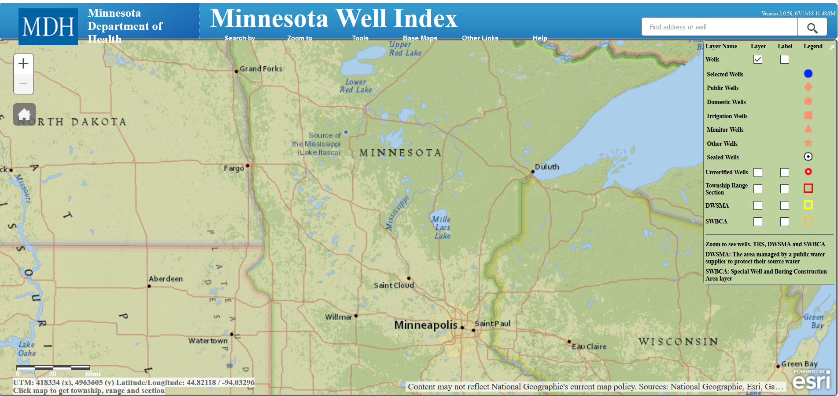
Screenshot of MDH Well Index map
https://www.health.state.mn.us/communities/environment/water/mwi/index.html
Notes:
Use this resource to look up your well and see if the state has a construction record for it.

Slide 133
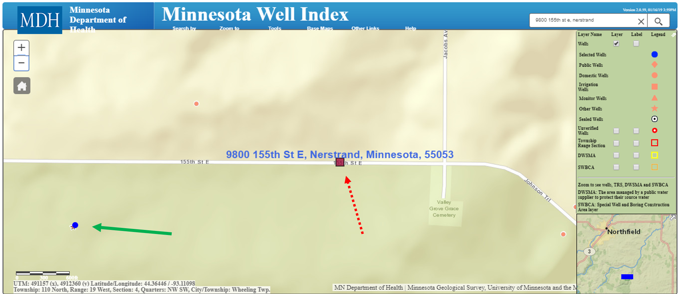
Screenshot of MDH Well Index map with unregistered well
https://www.health.state.mn.us/communities/environment/water/mwi/index.html
Notes:
Example of the Well Index map with a well location that is so old it does not appear in the list of registered wells.

Slide 134
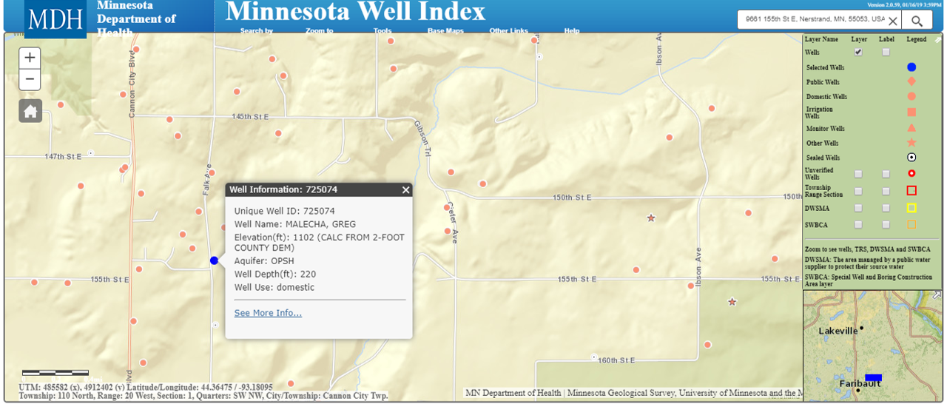
Screenshot of MDH Well Index map with a registered well location
https://www.health.state.mn.us/communities/environment/water/mwi/index.html
Notes:
Example of a well location that is in the Minnesota Well Index. Information about the well’s elevation, depth, and use (domestic private well) pops up for the location.

Slide 136
Food & Beverage Service
Notes:
Any time a food product changes hands in Minnesota counts as a “sale,” whether or not money is involved.

Slide 137
Notes:
The question is: “Do I need a license?” The answer is almost always “Yes.” This section comes out of the Come & Get It! What You Need to Know to Serve Food on Your Farm book, which is included in the binders and on the flash drives.

Slide 138
MINNESOTA STATUTES 157: FOOD, BEVERAGE, AND LODGING ESTABLISHMENTS
Minnesota Statute 157.16: License Required
Minnesota Statute 157.22: Exemptions
https://revisor.mn.gov/statutes/cite/157
Notes:
Minnesota Department of Health operates under Minnesota Statute 157.

Slide 139
Notes:
Potlucks and private meals for family and friends do not require a license. If you are posting a public notice about a meal, charging for the meal, or having food prepared by someone other than the guests at the meal, it isn’t really a potluck and you should get a license.

Slide 140
What is a potluck?
Notes:
A potluck is a meal shared by people who bring ready-to-eat dishes to share among the meal attendees.

Slide 141
What is a potluck?
Minnesota Statute 157.22 (Subdivision 8):
[No license is required for] food not prepared at an establishment and brought in by individuals attending a potluck event for consumption at the potluck event. An organization sponsoring a potluck event under this clause may advertise the potluck event to the public through any means. Individuals who are not members of an organization sponsoring a potluck event under this clause may attend the potluck event and consume the food at the event. Licensed food establishments other than schools cannot be sponsors of potluck events. A school may sponsor and hold potluck events in areas of the school other than the school's kitchen, provided that the school's kitchen is not used in any manner for the potluck event. For purposes of this clause, "school" means a public school as defined in section 120A.05, subdivisions 9, 11, 13, and 17, or a nonpublic school, church, or religious organization at which a child is provided with instruction in compliance with sections 120A.22 and 120A.24. Potluck event food shall not be brought into a licensed food establishment kitchen.
Notes:
Potlucks can be organized by individuals, organizations, and schools; but not by any licensed food establishments other than schools. However, a potluck could be held within a licensed food establishment so long as it was organized by a different entity and the licensed food establishment’s kitchen was not used to prepare or hold any of the food.

Slide 142
Church Lady Law
Minnesota Statute 157.22, Subdivisions 2 & 12
Notes:
Minnesota’s “Church Lady Law” exempts faith-based organizations in their houses of worship from license requirements when they serve food to the public.

Slide 143
Weddings, funerals, fellowship meals
Since 1995, a licensing exemption has been in place that allows faith-based communities to serve food at weddings, funerals, and fellowship meals within the house of worship. Those are considered private events for the faith-based community “family,” even if visitors may attend.
Notes:
Minnesota law exempts faith-based organizations in their houses of worship from license requirements when they serve food to the public as part of weddings, funerals, and other gatherings with a religious or fellowship function.

Slide 144
Church Lady Law
2012
In 2012, an exemption was added to allow faith-based communities to serve food at fundraisers or community events conducted in the building or on the grounds belonging to the faith-based community.
Notes:
This is Minnesota Statute 157.22 part 12. It applies when food is served in the building intended for worship or religious purposes, or on the grounds associated with such a building. It does not apply to church-owned buildings at county fairs or the State Fair, or other food service that may take place at locations other than the house of worship.
It is not clear whether the exemption applies in situations where an organization not affiliated with the faith-based community uses the house of worship’s kitchen for food preparation or food service. As of May 2019, there was disagreement on that point among MDH food regulatory staff.

Slide 145
Church Lady Law
There must be a certified food protection manager or a trained volunteer who trains food preparation workers in food safety
U of MN Extension offers “Cooking Safely for a Crowd”
Notes:
Cooking Safely for a Crowd training is specifically tailored to the Church Lady Law and the Fraternal, Sportsman, & Patriotic Organization exemptions.

Slide 146
Fraternal, Sportsman, & Patriotic Organizations Exemption
Tax-exempt fraternal, sportsman, or patriotic organizations can hold fundraiser meals in their building or on their grounds; with home-prepared, donated food.
M.S. 157.22 Subdivision 7
Notes:
This is Minnesota Statute 157.22 part 7. The organization must control either people’s access to the event or the event agenda, or both; and the event can’t be a circus, festival, or fair. If the organization’s building has a licensed kitchen, that kitchen cannot be used at all for the non-licensed event.

Slide 147
University & College Exemption
Colleges and Universities that have gone through a process to establish their own health code are exempt from food licensing in buildings they own or operate.
M.S. 157.22 Subdivision 3
Notes:
This is Minnesota Statute 157.22 part 3.

Slide 148
Soup & Chili Cookoff Exemption
Cook-off contests run as fundraisers by non-profit organizations are exempt from licensing. The language of the statute does specify “soup or chili.”
M.S. 157.22 Subdivision 14
Notes:
This is Minnesota Statute 157.22 part 3.

Slide 149
2019: Food Stand Exemption
Less than $1,000/year in sales
Operated as a Special Event or Seasonal Temporary Food Stand, with the 10- or 21-days of operation restrictions
Operated on private property
M.S. 157.22 Subdivision 15
Notes:
This is Minnesota Statute 157.22 part 15. It was passed by the Minnesota Legislature in 2019 with the intent of allowing children under the age of 14 to legally operate lemonade stands. However, the final language passed does not include an age restriction and does not limit the types of food that can be sold.

Slide 150
2019: Food Stand Exemption
No restrictions on type of food; food need not be approved source.
If potentially hazardous food is served, there must be a sign:
“The products sold at this stand are not subject to state inspection or regulation”
Notes:
This law is an exemption ONLY from M.S. 157 licensing requirements, which apply to food and beverage service.
It is not an exemption for public sales of raw or packaged agricultural products under the jurisdiction of the MDA.

Slide 151
Notes:
Potlucks and private meals for family and friends do not require a license. If you are posting a public notice about a meal, charging for the meal, or having food prepared by someone other than the guests at the meal, it isn’t really a potluck. If you don’t qualify for the small food stand exemption in M.S. 157.22 part 15, you should get a license.

Slide 152
Notes:
If your income, including donations, will be less than $1,000 per year and you will have less than 21 days of operation, you don’t need a license.

Slide 153
Notes:
Canned soda and bags of peanuts were exempted from licensing requirements in order to accommodate the Twins baseball team.

Slide 154
Notes:
What if?

Slide 155
What if there’s just food around and people eat it?
“If your farm business is serving food to the public, the licensing process applies. Serving food on your farm may be done for business reasons even if the product is free. If serving food boosts your farm’s name recognition, builds awareness, advertises products, or simply builds goodwill in the community for your farm, it is part of the business.”
-- Attorney Rachel Armstrong, Farm Commons; quoted in Come & Get It! (p. 8)
Notes:
Example: Catering business open house with ornamental displays of fancy dessert tarts as decorations. People are likely to pick up and eat them, even if the event wasn’t advertised as food being served. The presence of the desserts that people can pick up serves to advertise the caterer’s abilities.
The 2019 small food stand exemption may apply in the case of food and beverage service. You are still liable for harm if people get sick.

Slide 156
What if I just take donations?
Minnesota Statute 34A.01 Subdivision 12:
Sell; sale.
"Sell" and "sale" mean keeping, offering, or exposing for sale, use, transporting, transferring, negotiating, soliciting, or exchanging food; having in possession with intent to sell, use, transport, negotiate, solicit, or exchange food; storing, manufacturing, producing, processing, packing, and holding of food for sale; dispensing or giving food; or supplying or applying food in the conduct of any food operation or carrying food in aid of traffic in food whether done or permitted in person or through others.
https://revisor.mn.gov/statutes/cite/34A.01
Notes:
It’s still a “sale” if food is transferred from one person to another. Donations count toward the $1,000 per year limit of the 2019 small food stand exemption from food & beverage service licensing.

Slide 157
What if I have everyone sign a waiver?
“The law applies regardless of whether the guests want it to apply or not. Asking individuals to waive their rights or give your farm permission to serve from an unlicensed facility will not defeat the law.”
--- Attorney Rachel Armstrong, Farm Commons, quoted in Come & Get It! (p.8)
Notes:
And besides that, waivers aren’t worth the paper they are written on if someone did get sick from your food. Having product liability insurance is a really good idea if you’re serving food to the public.
The waiver has little value in a legal sense, but it can still be a valuable tool to catch people’s attention. If you have house rules or procedures you want people to follow, putting those on a form people have to sign can make them more likely to comply.

Slide 158
hmm
Notes:
Unless you are doing food and beverage service at a very small scale of less than $1,000 per year in sales or donations, and fewer than 21 days of operation.

Slide 159
Certified Food Protection Manager
If you need a license, you may also need to employ or become a Certified Food Protection Manager (CFPM).
M.S. 157.011; MN Rules 4626.0025 – 4626.0035

Slide 160
Certified Food Protection Manager
* The CFPM is responsible for ensuring food safety in your food and beverage service operation.
* The CFPM trains other staff in food safety, and appoints a Person in Charge (PIC) for each shift.
* There must always be a PIC present when the business is operating.

Slide 161
CFPMs are not required for:
Low-risk food establishments
Special event food stands
Establishments licensed as “Retail Food Vehicle/Portable Structure or Cart”
Establishments with very limited types of food handling
MN Rules 4626.0033

Slide 162
How do you become a CFPM?
Take training class and pass an approved exam.
Receive your exam certificate
Send an application, your exam certificate, and a $35 fee to the Minnesota Department of Health.

Slide 163
Questions?

Slide 165
Okay, how do I get a license?

Slide 166
Jurisdiction
Notes:
This has been alluded to earlier, but different agencies in Minnesota have responsibility for different parts of the food system and different license types. Figuring out which agency is the correct one to license a food business can be surprisingly tricky. Even inspectors have trouble.

Slide 167
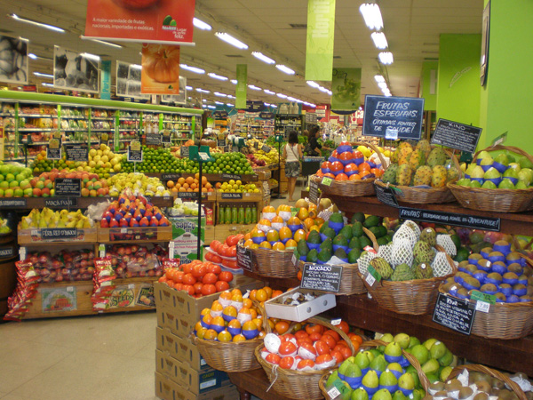
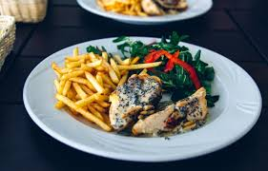
Ag
Health
Product Sales
Food & Beverage Service
Wikipedia Commons
The Wallpaper Co.
Minnesota Statute 157
Minnesota Statute 28A
Notes:
In the big picture, jurisdiction is divided between two state agencies: Minnesota Department of Agriculture and Minnesota Department of Health.

Slide 168
Jurisdiction
Ag: Food Processing
* Food manufacturing: processing of raw ingredients into packaged foods such as jars of pickles, frozen pizzas, boxes of cereal, cartons of milk

Slide 169
Jurisdiction
Ag: Product Sales
* Food handling: Buying and selling of packaged food products, bakery products, bulk food in dispensers, raw meats, or whole, raw fruits & veggies

Slide 170
Jurisdiction
Ag: Product Sales
* Farmers’ sales of their own farm products

Slide 171
Jurisdiction
Ag: Other Commercial Food Activities
* Other food things that don’t fall under the jurisdiction of the Minnesota Department of Health (example: meat slaughter & processing)

Slide 172
Jurisdiction
MN Department of Health
Food and beverage service: preparing and serving foods to individuals

Slide 173
Jurisdiction
Health
Food & Beverage Service
Minnesota Statute 157
Notes:
For on-farm food service or food service at associated festivals, the regulatory authority is probably Health – unless the only products sold are pre-packaged items like bags of cotton candy or kettle corn. There’s a Memorandum of Agreement between Ag and Health about which of these “in between” products each will regulate. In practice, the inspector covering a festival will probably be the one whose agency has jurisdiction over the majority of the food stands there.

Slide 174
Jurisdiction
Physical Location
51% Rule
Notes:
At any physical location where a business operates, a license is needed. MDA and MDH has a memorandum of agreement that each licensed location will only have one food license, and it will be based on the majority of sales at that location.

Slide 175
Jurisdiction
Physical Location: 1 food license (either Ag or Health) - per location - per legal entity
Notes:
Sometimes a physical location such as a shared-use kitchen has more than one legal entity operating there. In that case, each legal entity needs to operate under its own license, or exclusion, or exemption. There is no such thing as a “kitchen license” that covers all the activity that may take place there by multiple entities.

Slide 176
Jurisdiction
51% Rule: The majority of dollar sales at a location determines the license type
Notes:
Example: retail store with attached café, under the same ownership. If more than half of annual food sales are coming from the store, the license will be issued by MN Dept of Agriculture. If more than half of annual food sales are coming from the café, the license will be issued by MN Dept of Health. Either way, both the store and café will be covered by the license that is issued.

Slide 177
Jurisdiction
51% Rule: Applies to Licenses, not Facilities and not Processes.
(You always need the appropriate equipment and process for what you’re doing.)
Notes:
Example: A wholesale food manufacturer/processor that cuts and bags fruits and vegetables may also have a small counter area with a couple of chairs where they serve smoothies and scones to the public. The smoothie sales are less than half of total sales, so the license is a wholesale food manufacturer/processor license; but the equipment used to hold ingredients, bake the scones, and make the smoothies must meet Minnesota Food Code requirements for those activities.

Slide 178
Licenses
Minnesota Department of Health
License Types:

Slide 179
Licenses
Special Event Food Stand
Food cart
Seasonal Temporary Food Stand
Seasonal Permanent Food Stand
Mobile unit (food truck)
Food & Beverage Establishment – Category 1, 2, or 3
Minnesota Statute 157.16 https://revisor.mn.gov/statutes/?id=157.16
Notes:
Food & Beverage Establishment Licenses are risk-based. Special Event Food Stands are defined as low-risk, no matter what they are serving. The low-risk designation is because they operate for such a limited period of time. All of the other license types get a risk category based on their menu. Examples:
Category 1 – low risk - continental breakfast: rolls, coffee, juice
Category 2 – medium risk – pizza, grill menu
Category 3 – high risk – full-service restaurant with hot and cold holding of food
Risk category determines plan review fees, license fees, and frequency of inspection.

Slide 180
Licenses
MDA License Types:
* Retail Food Handler
* Wholesale Food Handler
* Wholesale Food Manufacturer/Processor
* Food Broker
Notes:
Retail Food Handler – business that sells packaged foods or raw agricultural products to the end consumer. Think grocery store, or similar.
Wholesale Food Handler – business that sells packaged foods or raw agricultural products to other food businesses. Think distributor or food hub.
Wholesale Food Manufacturer/Processor – business that uses food ingredients to produce packaged food products for sale to other food businesses. A Cottage Food Producer who is stepping up to licensed production in order to sell jam to a grocery store would get a Wholesale Food Manufacturer license.
All of these three license types also follow the 51% rule, so if you are making jam to sell both at retail and wholesale, if retail sales are the majority of your income from the jam, the license will be a Retail Food Handler.
The Food Broker license is kind of its own island. Food Brokers arrange sales, take orders, dispatch deliveries, handle invoicing and payment – but do not actually take possession of the product at any point. If they took possession of the product in order to deliver it, they would be a wholesale food handler. Licensed food brokers may not take possession of the product, so if there’s a business that wants to do some broker-type sales but also some deliveries, they need a wholesale food handler license even if broker-type sales are the majority of their sales.

Slide 181
License Fees
What do MDH licenses cost?
Special Event Food Stand: $55/yr Seasonal or Mobile: $85/yr
Food Establishment:
Annual base fee: $165/yr +
additional $110 to $385 depending on risk category
Notes:
These license fees are in statute for MDH, but delegated authorities in cities or counties could have a different fee structure.

Slide 182
License Fees
Additional one-time cost for Plan Review for retail licenses.
MDH Plan Review fee:
Not required for Special Event Food Stand
$250 to $500 for other license types, depending on risk category
Notes:
For Seasonal Temporary, Seasonal Permanent, and Mobile food licenses, the license fee is a flat fee not tied to their risk category, but the Plan Review is still required.

Slide 183
License Fees
What do MDA licenses cost?
Retail Food Handler: $77/yr
Wholesale Food Handler: $57/yr
(These are the lowest rates. Fees increase as annual revenue increases.)
Notes:
Food handler licenses from MDA are shown at the lowest rate. Fees increase as annual revenue increases.

Slide 184
License Fees
Additional one-time cost for Plan Review for retail licenses.
MDA Plan Review fee: $200 to $425, based on square footage
Notes:
MDA wholesale licenses do not have a formal Plan Review process. There is still a requirement to work with an inspector to gain approval of the facility.

Slide 185
Notes:
MDA wholesale licenses do not have a formal Plan Review process.

Slide 186
Getting Stuck in the Food Licensing System
Notes:
This happens quite a bit, especially to farmers and food entrepreneurs doing innovative things in local food systems. Very often these creative enterprises will straddle the boundaries of licenses and regulators won’t be familiar with the model.

Slide 187
Licensing
Ag
Health
Food & Beverage Service
Product Sales
Local Food System
Notes:
Sometimes when an enterprise includes both a product sales component and a food service component, things don’t quite match up in the middle. MDA and MDH regulate different types of enterprises and operate under different statutes. They have different cultures within the agencies and field inspectors operate in different ways. The Health inspectors who are regulating the buyers aren’t necessarily well-versed in the product regulations understood by the sellers and the Ag inspectors.

Slide 188
Licensing
Be alert to situations that need clarification!
Ag
+
Health
+
Delegated Authorities
Notes:
It gets more confusing when you add delegated authorities. Just be aware that confusion over licensing requirements and jurisdiction can happen, so pay attention to times when that could be happening and don’t take “No” as the first answer. Ask for clarification.

Slide 189
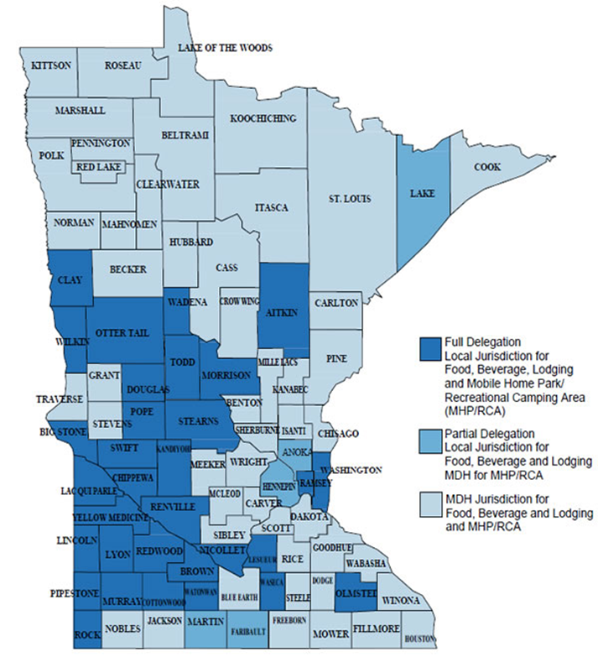
MN Dept. of Health Map of Delegated Authorities
www.health.state.mn.us/divs/eh/food/license/delegation.html
Notes:
Just to make it more fun – Health is not one agency! The Minnesota Department of Health gives delegated authority to some counties and cities that have the capacity to do inspections, issue licenses, and fulfill the public safety mission of the MDH. If you are in a delegated authority city or county, you will have an employee of that local government as your inspector.
IMPORTANT: Look up the current map. Delegated authority areas drop in and out, so you need find the most up-to-date map at the link on the MDH website.

Slide 190
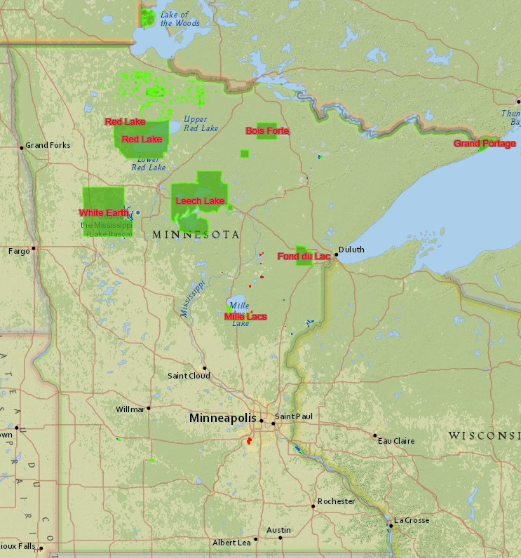
Tribal lands within MN state boundaries
Notes:
Tribal sovereignty applies to food on tribal lands. Tribes may have their own food code.

Slide 191
MDA has 7 delegated authorities
BUT only delegates authority for retail food facilities
(No delegation for wholesale handling or manufacturing or meat)

Slide 192
MDA delegated authorities cannot be more restrictive than the MDA. The state food code is a minimum and maximum code for MDA.
M.S. 28A.06
Notes:
Mobile vendors – MDA license is good statewide. MDH doesn’t have that provision. Counties or cities with delegated authority may require that a mobile vendor purchase another license to operate in that county or city.

Slide 193
* Delegated Authorities under both MDA and MDH may have different license names and fee structures
Notes:
Again, always ask for clarification if it seems like the requirements you are facing don’t match up with what your business actually is. You might be talking to the wrong agency.

Slide 194
Break – followed by scenarios to be discussed in small groups
Notes:
There are seven scenarios drawn from real cases that came in to MISA, MFMA, or RTC.

Slide 195
1. A farmer wants to construct an on-farm commercial-grade kitchen to manufacture a food product for local and regional sales. [County with Health delegation]
Notes:
Answer: The fact that the county has delegation authority from the Department of Health should not affect this farmer, because what he intends to do would fall under the jurisdiction of the Minnesota Department of Agriculture. The license he should get is wholesale food manufacturer/processor. However, because he didn’t understand jurisdiction and went to his county health inspector first, he got started down the wrong path. The county health inspector should have handed this off to Ag, but that didn’t happen right away.

Slide 196
KZ - The K family is putting in a commercial kitchen on the farm. County guy says commercial kitchen is a restaurant so needs a hood; MDA says no hood ....... no resolution.
J. - Is this a commercial kitchen for food processing/product manufacturing, or are they doing on-farm food service?
KZ - They are doing: food processing/product manufacturing.
Notes:
Some of the back-and-forth about this farmer’s license and the requirements he was facing from an inspector for food and beverage service. The inspector knew restaurant requirements, and that’s what he was telling the farmer to install.

Slide 197
J. - In that case the local delegated authority shouldn't have jurisdiction over it -- it's MDA jurisdiction. The only thing County should be dealing with is the zoning, septic, and water.
KZ – K. is reluctant to really piss off his local - because that's who he has to deal with long term, right?
J. - Why does he have to deal with his local guy in either the short or the long-term? If he's doing food manufacturing/processing, his inspector should be an MDA inspector -- not the local guy.
Notes:
Endless confusion.

Slide 198
Epilogue, 3/21/17:
K. had gone back and forth between the local delegated authority and the MDA inspector over the ventilation hood requirement, and finally the local delegated authority person had thrown up his hands and agreed it was MDA’s call.
Notes:
It should never have taken as long as it did. If you are in a position to provide advice or advocate for business owners, this is the kind of thing you need to watch for.

Slide 199
2. Multi-location food service with central office space wants to set up a walk-in cooler at the office for collection & distribution of local veggies to their own feeding sites.
[City with both Ag and Health delegation authority]
Notes:
A key point here is the multiple locations. Each feeding site has its own license because each one is a separate physical location. The central office space is also a separate physical location. That walk-in cooler should be licensed through the City’s Ag delegation authority as a wholesale food handler, for collecting and distributing vegetables to the feeding sites. Instead, because the feeding sites are licensed as food and beverage service establishments through the City’s Health delegation, both the food service business and the City started out with the assumption this would be a food & beverage license. That led to unnecessary and expensive requirements for the office location to install stainless steel tables and triple-wash sinks. This got sorted out, but it took awhile.

Slide 200
3. Food entrepreneur wants to manufacture a packaged dry snack product out of a rented commercial-grade kitchen and sell it to grocery and convenience stores. [City without delegation authority]
Notes:
This was a case where jurisdiction got confused within an agency. This is wholesale food handling, but the MDA at first incorrectly routed it to a retail food inspector who was making the food entrepreneur go through plan review and install facilities required for retail licensing. This confusion arose partly because the food entrepreneur was planning on a small amount of retail sales, so he got routed to retail even though the majority of his business was wholesale food manufacturing.

Slide 201
4. Local farmers’ market wants to collect produce from multiple vendors to fill orders from schools, hospitals, & restaurants in that county and adjacent counties. [County without delegation authority]
Notes:
The farmers’ market is acting as a distributor of the farmers’ produce, so it isn’t Product of the Farm anymore. It isn’t the product of the farmers’ market’s farm, so the farmers’ market needs a wholesale food handler license, which is under the jurisdiction of the MN Dept of Ag. However, the potential buyers for the produce – schools, hospitals, restaurants – are regulated by Dept of Health. It would be wise for the farmers’ market to reach out to the Health inspector to explain what they’re doing and make sure the Health inspector understands the legality of the local product.

Slide 202
Event planner wants to arrange an on-farm festival that includes a dinner with ingredients sourced from several local farms, plus a pop-up farmers’ market. [County with Health delegation]
Notes:
No license is needed for the pop-up farmers’ market. Farmers’ markets can meet anywhere that is permitted by local zoning. However, the host farm should think about limiting its liability by making sure that each vendor at the pop-up market has the correct license or exemption for what they are selling. The dinner needs to be licensed. If it’s being prepared somewhere else by a caterer and just served on the farm, the caterer’s license will cover it. If food preparation is taking place on the farm, there needs to be a special event food stand license.

Slide 203
6. County SHIP coordinator wants to establish a Farm to School program in a school district, with direct purchasing of food from area farmers.
[County with delegation]
Notes:
No licensing is needed in order to launch this program. The school is already cooking and serving food, and is licensed and inspected for that by the MN Dept of Health or a local delegated authority. The farmers do not need a license to sell their product of the farm, and the school does not need any extra licensing or permitting to buy it. If a farmer is selling a product with off-farm ingredients added, that farmer will need the correct license in order to sell the product. Cottage Food cannot be used by the school.

Slide 204
7. Local civic group wants to offer a summer lunch program for area youth on three days per week.
[County with delegation]
Notes:
This is food and beverage service, so it will be licensed by the local delegated authority under the jurisdiction of MN Dept of Health. If this were a faith community serving the food out of their house of worship, a license would not be needed. Communities of faith are exempt under the 2012 “Church Lady Law.” Since this is a civic group, a license is needed. Depending on how many weeks the program runs, it could be done with a Seasonal Temporary Food Stand license, which allows 21 days of operation with discretion for the local authority to allow extra days.

Slide 205
Licensing
Ag
Health
Food & Beverage Service
Product Sales
Local Food System
Notes:
Always remember the potential for confusion about jurisdiction and legality of local food. MDA and MDH regulate different types of enterprises and operate under different statutes. Enterprises or programs that straddle the divide can get tangled up in the system.

Slide 206
Don’t Stay
Stuck!
Notes:
If you get tangled up and stuck, don’t just throw up your hands in dismay and decide it can’t be done. Reach out for help.

Slide 207
Licensing
Reach out for help:
Agree with your inspector to ask for clarification from agency supervisors
Contact agency supervisors on your own
Contact an organization to help you get clarification from agencies
Notes:
It’s best if you can work with your inspector to figure things out. Always ask for clarification from your inspector as a first step. If that is not satisfactory, escalate it. Agency supervisors are very accustomed to fielding questions and requests to straighten out complications from larger-scale food businesses. Many farmers and small-scale food entrepreneurs do not know how to move up the chain within the agencies and are reluctant or afraid to do so. If that’s the case, reach out to the project team: MISA, MFMA, RTC, and Extension. We know who to ask and how to ask.

Slide 208
Food Innovation Team
Notes:
The Food Innovation Team, or FIT, exists to take difficult cases and untangle them. It consists of four regulatory agency representatives and four members of the sustainable agriculture / local food / small-scale food entrepreneur community. There is one member each from MDA, MDH, MDA delegated authority, and MDH delegated authority.

Slide 209
Innovation Team Intake Pathways
Community-based groups with food system expertise
Delegated authorities
MDH
MDA Food & Feed Division administrators
Innovation Team
MDA
MDH
Delegated authorities
Local food/maker community groups
License applicant
Ad hoc experts
MDA
Notes:
If you encounter a situation that seems to be mired in confusion, send it to FIT. We’ll figure it out. The mission of FIT is twofold: one, we figure out an answer for the food entrepreneur so they can move forward. Two, we capture the details of the case and how it was resolved, and feed that back to the agencies so there can be some system learning about how to handle similar cases. Contact MISA, MFMA, or RTC for assistance if you want to submit a case to FIT.

Slide 210
Thank you!
Jane Grimsbo Jewett Associate Director
Minnesota Institute for Sustainable Agriculture
University of Minnesota jewet006@umn.edu, 218-670-0066
Kathy Zeman
Executive Director
Minnesota Farmers’ Market Association kzeman@mfma.org
Brett Olson
Creative Director & Co-Founder
Renewing the Countryside
brett@rtcinfo.org

Slide 211
Blazing Trails through the Jungle of Local Food Regulations
www.misa.umn.edu/resources/blazing-trails
Funded by:
North Central Sustainable Agriculture Research & Education Program
(NCR-SARE)

