Slide 1
Paycheck Protection Program: Who is eligible & How to apply
Live Webinar:
February 16, 2021 11:30 pm to 12:45 pm

Slide 2
PPP 2 Sponsored by:

Slide 3
Presenters:
Megan Roberts, University of Minnesota
Stephen Carpenter, Farmers’ Legal Action Group
Lindsay Kuehn, Farmers’ Legal Action Group

Slide 4
Refresher on current disaster relief programs
CFAP 1 & 2 Additional Assistance - February 26
QLA - March 5
PPP 1 & 2 - March 31
EIDL - December 31
CFAP 3 - Unknown
Notes:
Megan: There are numerous COVID-19 and/or disaster programs still open for sign-up. Here are some key dates. This presentation

Slide 5
PPP: A forgivable loan to cover 2.5 months’ worth of payroll costs for small businesses, including farmers, impacted by COVID-19.
Overview of Paycheck Protection Program
Created by CARES Act to help employers keep employees, PPP changed in late December 2020
PPP vs. EIDL
Notes:
Megan: Emphasize that it applies to business owners broadly--you do not need to show a LOSS for PPP 1. It is different than EIDL. Note to audience that Lindsay will cover in more detail in upcoming section.

Slide 6
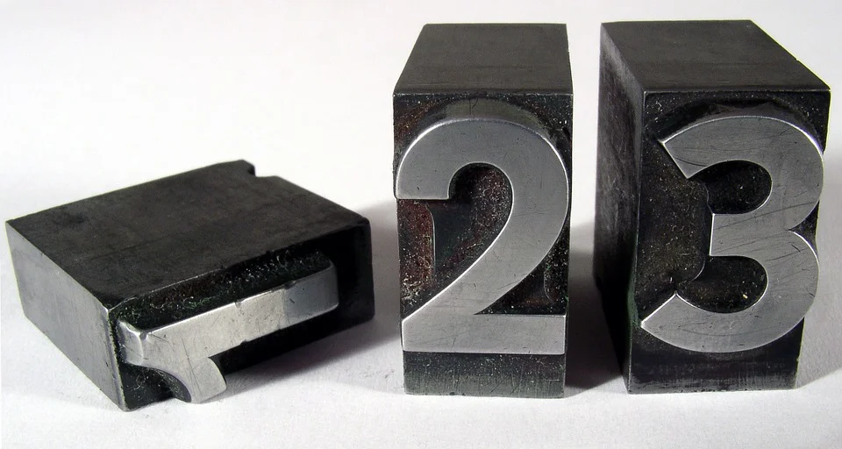
Two types of PPP
1st draw: If you haven’t received a PPP law previously or if you could increase your PPP loan amount using gross income, start here.
2nd draw: If you have previously received PPP and can show a 25% decline in receipts in at least one quarter of 2020.
We will talk about both 1 & 2 today.
Notes:
Megan

Slide 7
Mythbusting: I don’t think I qualify because...
I had negative or low net farm income.
I don't have employees
My farm is seasonal
My farm is very small
I don’t want debt
Isn’t it a lot of paperwork?!?
Notes:
Megan

Slide 8
General Eligibility for PPP First and Second Draw Loans
Eligible Businesses
Businesses: tribal, non-profit, veterans organizations, partnerships
*Now also: housing cooperatives, 501(c)(6) organizations, destination marketing organizations and certain news organizations
Agricultural producers, farmers, and ranchers
Self-employed individuals, sole proprietorships, and independent contractors
Fewer than 300 employees (or < 500 if a first draw PPP loan)
In business as of February 15, 2020
*Seasonal employers: any 12-week period between 2/15/19 and 2/15/20
Only one first draw and second draw PPP loan per borrower (exception for first draw loan recalculations)
Notes:
*Notes on Business Size---First Draw Loans generally have a max of 500 employees; Second Draw Loans have a max of 300
* b/c you only get one bite at the apple, so to speak, apply for the max
*Also--principal place of residence must be in the U.S.

Slide 9
Specific Eligibility Rules for Second Draw Loans Only
Previously received a PPP loan
Must use the entire amount of the first PPP loan—on allowable uses—by the time the second draw PPP loan is disbursed.
Revenue reduction of at least 25% in 2020 compared to 2019
Many ways to show this, but in general need at least one quarter of 2020 to have 25% fewer gross receipts than in 2019
Can rely on 2019 and 2020 tax returns if you do not have quarterly gross receipts
For self-employed farmers, can compare 2019 and 2020 Schedule F (sum of lines 1b and 9)
Notes:
*Note on using proceeds of first PPP loan--this includes any potential increase a borrower applies for
*For Schedule F filers, demonstrating revenue reduction can mean comparing the sum of lines 1b and 9 from Schedule F for 2019 and 2020 (Details on treasury FAQ for second draw loans--How to Calculate Revenue Reduction)

Slide 10
What Makes Someone Ineligible for a PPP Loan?
Delinquent or in default on a federal loan
Engaged in illegal activity
Household employer (someone employing people such as nannies or housekeepers)
Some bankruptcies: anyone involved in a bankruptcy proceeding between when the PPP application is submitted and when the loan funds are disbursed is ineligible
Business has permanently closed
*Additional rules apply and some are different for second draw PPP loans (for example,

Slide 11
Allowable Uses of First and Second Draw Loans
Payroll Costs: (1) salaries, wages, tips, and similar compensation (capped at $100k/per employee per year); (2) group health, life, disability, vision, and dental coverage; (3) retirement benefits; (4) vacation, sick, parental, and family leave
Self-Employed—Owner Compensation Replacement: wages, commissions, income, etc. (use Schedule C or Schedule F)
Business expenses: mortgage interest payments; rent/lease payments; utility payments
Now Also: operations expenditures; property damage costs; supplier costs; worker protection expenditures
*SBA may seek repayment of any funds used for non-allowable purposes
Notes:
*For first draw PPP loans only--can also use funds to refinance an EIDL loan made between 1/31/20 and 4/3/20
*Likely that to be allowable, must have incurred the obligation as of 2/15/20

Slide 12
How Much Money Can I Receive From a PPP Loan?
General Rule: 2.5 times your average monthly payroll
For Self-Employed: 2.5 times owner compensation replacement
Schedule F filers: gross income from line 9 of Schedule F
Schedule C filers: net income from line 31 of Schedule C
Notes:
*Detailed guidance on how to determine owner compensation replacement when have employees:
FIRST DRAW: https://www.sba.gov/sites/default/files/2021-01/PPP%20--%20How%20to%20Calculate%20Maximum%20Loan%20Amounts%20for%20First%20Draw%20PPP%20Loans%20%281.17.2021%29-508.pdf
Second DRAW: https://www.sba.gov/sites/default/files/2021-01/Second%20Draw%20PPP%20Loans%20--%20How%20to%20Calculate%20Revenue%20Reduction%20and%20Maximum%20Loan%20Amounts%20%281.19.2021%29-508.pdf

Slide 13
Amount of First or Second Draw Loan:
Self-employed with No Employees.
Select either 2019 or 2020 IRS tax forms
Schedule F—gross income from line 9
Schedule C—net profit from line 31
Maximum PPP loan amount:
Average monthly gross income/net profit ÷ 12
x 2.5
$ Total PPP loan amount
NOTE: For first draw loans, also add in any outstanding amount of an EIDL made between 1/31/20 and 4/3/20
Notes:
*For first draw PPP loans, you can also include any outstanding amount of an EIDL loan (not grant) made between 1/31/20 and 4/3/20 (ie: can refinance outstanding EIDL if you wish)

Slide 14
Amount of Second Draw Loan:
Self-Employed with Employees.
Select either 2019 or 2020 Schedule F
Determine payroll amount:
(1) difference between gross income from line 9, and the sum of lines 15, 22, and 23; + (2) gross wages/tips; + (3) contributions to benefits/retirement
Maximum PPP loan amount:
Payroll ÷ 12 (to get average monthly payroll)
x 2.5
$ Total PPP loan amount
NOTE: For first draw loans, add in any outstanding amount of an EIDL made between 1/31/20 and 4/3/20
Notes:
Note: a useful pdf on calculating loan amounts is found here: https://www.sba.gov/sites/default/files/2021-01/PPP%20--%20How%20to%20Calculate%20Maximum%20Loan%20Amounts%20for%20First%20Draw%20PPP%20Loans%20%281.17.2021%29-508.pdf

Slide 15
Amount of First and Second Draw Loan:
Seasonal Employer
Select any 12-week period between 2/15/19 and 2/15/20
Maximum PPP loan amount:
Average monthly payroll costs for employees
x 2.5
$Total PPP loan amount
NOTE: For first draw loans, add in any outstanding amount of an EIDL made between 1/31/20 and 4/3/20

Slide 16
Do I qualify for a larger 1st draw PPP loan?
Who is eligible for an increased first draw PPP loan?
Farmers/ranchers who received a PPP loan prior to 12/27/20
Seasonal employers that received a PPP loan prior to 12/27/20
Partnerships that did not account for partner compensation
Not accept, by 12/27/20, entire PPP loan for which approved
Returned part of a first draw PPP loan prior to 12/27/20
Who may reapply for a new first draw PPP loan under current rules?
If returned entirety of first draw PPP loan prior to 12/27/20
How to apply for a loan increase:
Lenders must submit the request electronically on or before 3/31/21
Notes:
SBA procedural notice from 1/13/21 on recalculations/increases is at: https://home.treasury.gov/system/files/136/PPP--Procedural-Notice--First-Draw-Paycheck-Protection-Program-Loan-Increases-After-Enactment-Economic-Aid-Act.pdf

Slide 17
Questions about eligibility?

Slide 18
What information do I need to fill in the application?
Generally:
2019 or 2020 Schedule F
2019 or 2020 Form 943
If you make pre-tax benefits contributions,
this information is needed, too.
SBA website or lender may be helpful.
Notes:
Megan

Slide 19
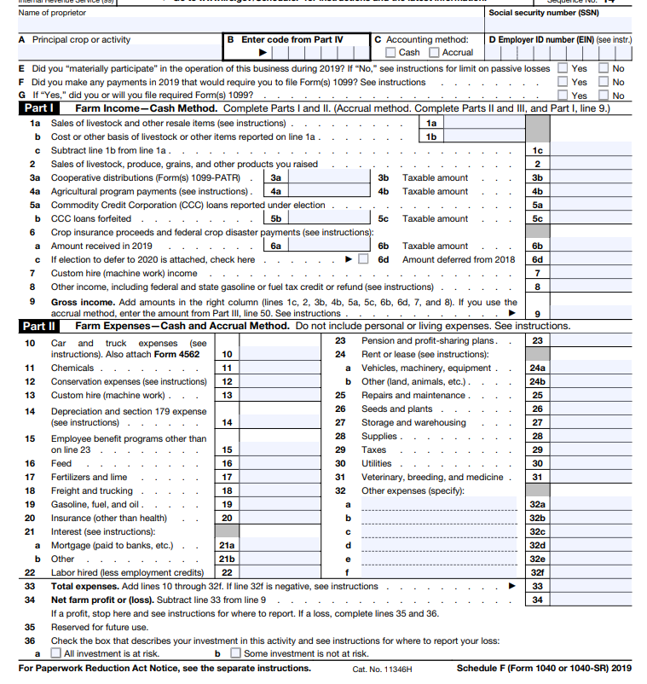
Without employees, line 34 is key.
With employees, Form 943 + benefits is helpful.

Slide 20
Example: Let’s do some new math
Now, if line 9 of the Schedule F was $113,000 and you have no employee payroll then
$100,000/12 x 2.5 = $20,833.
$20,833 is the requested PPP amount. Because 113,000>100,000 we reduce our annualized request to the maximum of $100,000 per person.

Slide 21
Example: Let’s do some old math
Previously if line 34 of the Schedule F was $42,000 and you have no employee payroll then
$42,000/12 x 2.5 = $8,750.
$8,750 is the requested PPP amount.

Slide 22
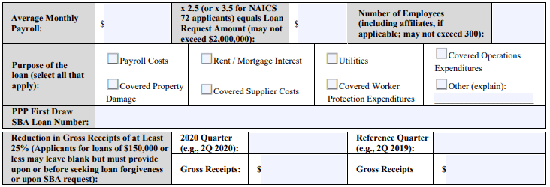
2nd Draw Application - A Couple Extra Steps!

Slide 23
Tips for successfully applying
You are working with lenders not directly SBA
Gather all the needed tax documentation.
Fill out the SBA application ahead of time.
Be aware some lenders use their own forms.
Advocate for your eligibility.
Don’t wait until March. Give yourself time.

Slide 24
Potential issues with lenders
Misconception that ag is not eligible
May prefer to work with existing clients
May not have accessible applications
But--there are many lenders looking to help!

Slide 25
Lenders who have agreed to offer PPP loans
SBA offers a free matching service: www.sba.gov/funding-programs/loans/lender-match
Still pondering where to go? Ask your fellow farmers. Did they have a good experience?

Slide 26
Questions about applying?

Slide 27
Documentation
Although forgiveness applications have become easier, requirement to keep documentation remains.
“The Borrower must retain all employment records/payroll documentation in its files for four years and all other documentation for three years after the date the loan forgiveness application is submitted to the lender” SBA Form 3508S, page 4
Tax forms, receipts, payroll stubs, bank account statements, etc.
Notes:
Stephen

Slide 28
Meeting forgiveness requirements of a PPP loan
100% forgiveness of PPP loan principal and interest is possible
To receive 100% forgiveness of PPP loan:
60% used on payroll costs or owner compensation replacement
40% used for utilities, mortgage interest, and/or rent
Wages remain within 75% of what they were during Q1 of 2020
Number of FTE employees remains the same
Up to 24 weeks to use funds
If rules not fully followed, can receive partial forgiveness
Any part of PPP loan not forgiven has 1% interest over five years

Slide 29
What do you do if you’re denied?
If denied for a PPP loan, or for loan forgiveness, the borrower can appeal to SBA.
SBA says it will issue another rule to outline the appeals process.

Slide 30
Remaining questions?

Slide 31
For more information:
Megan Roberts, meganr@umn.edu
Stephen Carpenter, scarpenter@flaginc.org
Lindsay Kuehn, lkuehn@flaginc.org
This presentation is educational information and not intended as legal, tax, or accounting advice.

